Slide 1
FY 2024 Space Survey Training for Non-Research Areas

Slide 2
What is a space survey?
The purpose of the space survey is to confirm the rooms used by each department, gather information on how that space is used, and to verify attributes, such as room type and square footage.
This information is always very important for monitoring or preparing the Facilities and Administrative (F&A) Rate Proposal among other uses. All activity in the current fiscal year will be consolidated into the F&A proposal to develop overhead rate calculations that will help prepare us for the next base year.
5

Slide 3
What is a space survey? (continued)
The space survey is a critical part of the F&A proposal because it determines how most of the facility costs (equipment and building depreciation, interest and operations and maintenance expenses) will be allocated to organized research.
Because space has such a substantial impact on the costs allocated to the federal government, it is essential that the survey is done in accordance with the federal regulations and the results are accurate.
In addition to the F&A proposal, the space survey is also used for rent proration, space analysis and planning, management reporting, and financial statement allocations.
6

Slide 4
Survey Definitions and Time Frame
Impact: FY23 F&A expenses recovered = $235,869,
This recovery is reinvested back into the university to help support the many missions of WashU!

Slide 5
Space and User Groups
Lots of areas are interested in our university space.
Here are a few of our users:
Property Accounting | Facilities & Property Management
Sustainability | WorkDay/Student Sunrise
Capital Projects | Finance
In other words, our space data is very important to many different areas of WashU!

Slide 6
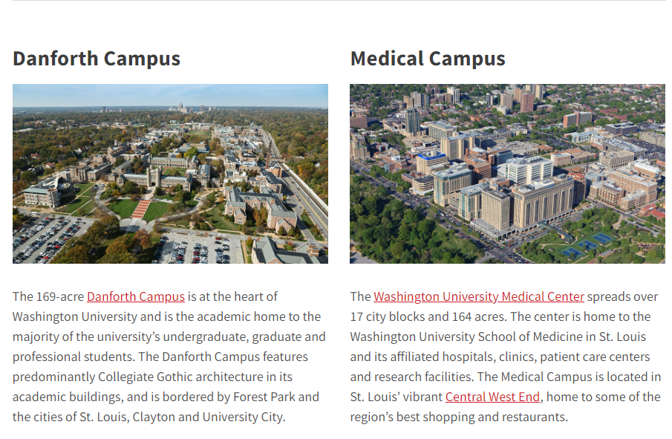
WashU’s Space
Did you know?
In total, WashU covers more than 2,000 acres and more than 150 major buildings.
Campuses Include:
Danforth
Medical School
West Campus
North Campus
South Campus
Tyson Research Center
Source: https://wustl.edu/about/campuses

Slide 7
Survey Definitions and Time Frame
In order to keep our space data as accurate as possible, ManageSpace conducts two different survey cycles, each with different objectives and goals.
Survey #1 – Planning Survey→ High level objective is to keep department space as up to date as possible.
Survey Timeframe: September – End of May*

Slide 8
Survey Definitions and Time Frame
Survey #2 – Annual Survey→ High level objective is to confirm space was reported correctly throughout the year and to functionalize department space with IDC code(s) (indirect cost codes) that match the type of activity that has taken place throughout an entire fiscal year.
Survey Timeframe: June – Mid July

Slide 9
Survey Definitions and Time Frame
The annual survey is also used for rent proration, space analysis and planning, management reporting, and financial statement allocations.
This is a department’s final stamp of approval the activity captured throughout the year within the Planning Survey is an accurate reflection of what really happened in space.

Slide 10
How Survey Data Flows from year to year
7
Notes:
This is a representation of how the data flows from FY20 Planning to FY21 planning and from FY20 Planning to FY20 Annual but notice, it does not go from FY20 Annual to FY21 Planning. Any changes that are made during the Annual Survey that should have been made during the Planning Survey will have to be re-entered in the FY21 Planning Survey. Since these changes will not persist into the next survey, please make a record of them so they will not be missed in FY21

Slide 11
FY24 Survey Timeline
Date | Activity
May 31, 2024 | Planning Survey closes at 5pm
July 12, 2024 | FY24 Annual Survey Ends / FY24 Annual Space Survey Results Reviewed
September 2024 | FY24 Annual Survey Archived / FY25 Planning Survey Opens

Slide 12
Workday CCHRU
Since the Workday Implementation
Departments are no longer departments in Archibus.
Space was converted from a department number to a Cost Center Hierarchy Value (CCH).
Business Managers and Department Heads chose what hierarchy level to report space.
Which CCH level space can be assigned to in ManageSpace is determined by the CCHRU level in Workday
1

Slide 13
CCHRU
Lowest level space is reported. This could be at the cost center level or a hierarchy level.
Highest level space rolls up too. This could also be at the cost center level or hierarchy level.
In this example, all 3 of the CCH Rollups live under CH00007. In the past, the Main CCH would have been 001600 and the CCH Rollup would have been the individual department numbers. (001660)
2

Slide 14
Planning vs Annual Survey
Planning Survey Cycle Goals:
Confirm and Update Room Splits (Responsible Party, Department, Recharge Center, % of Space)
Request Room Updates
Use Effective Dates
Confirm Responisble Party (PI/PO)
Create Service-Benefiting Room Relationships
Planning Survey data is ‘Annualized’ by the system and becomes the initial Annual Survey data
Annual Survey Cycle Goal:
“Functionalize” how the space was used during the Fiscal year by assigning Space Function Codes to room splits
8
Notes:
Planning versus Annual.
The goals for the Planning survey are –
Confirm and update room splits for the responsible party, occupying department, recharge centers, and percentages of space.
Requesting room updates – this is the only time when you can request updates
You must use effective dates.
You should add occupants to splits
Create service/benefiting room relationships
This information will become the beginning data for the Annual survey and for the FY23 Planning survey.
The goal of the Annual survey is to functionalize the room splits by assigning Function codes.

Slide 15
FY 2024 Space Survey How to Perform Your Portion of the Survey

Slide 16
Planning Survey - How to Start?
If possible, walk your space with a floor plan from OSIS.
Review the Room inventory and Space Utilization reports
Confirm Room number, Department (Occupant and Assignee), Room Type, Square Footage
Confirm Responsible Party (PI/PO)
10
Notes:
How to start. It’s a good idea to walk your space to at least once a year. With Covid restrictions, we know that hasn’t been possible.
Update the Occupants and their funding accounts. Remember to only include funding for activities done in that split. ManageSpace will bring in all accounts associated with the occupant not just the accounts that were worked on in that split

Slide 17
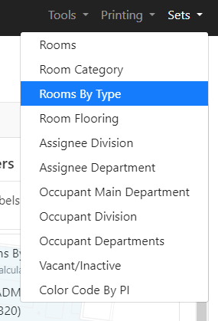
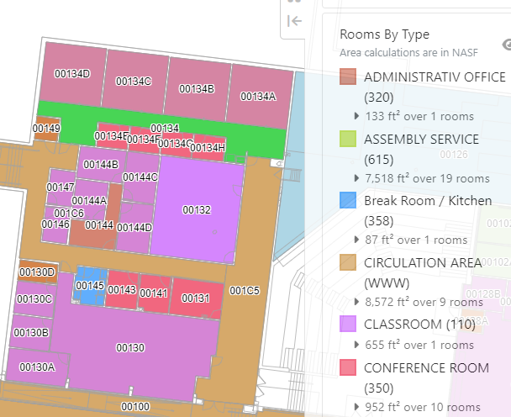
OSIS – Floorplans and Views
Choose how you’d like to review the data from the Set tab.
Review by Room Type

Slide 18
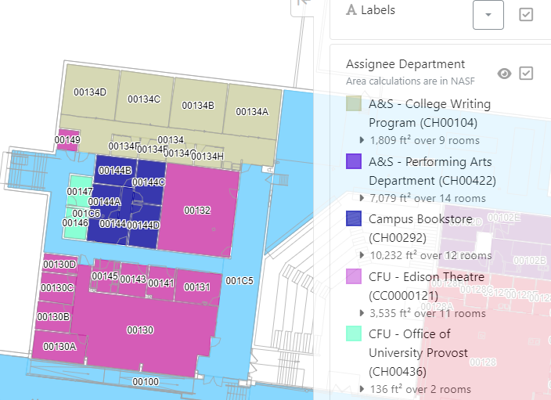
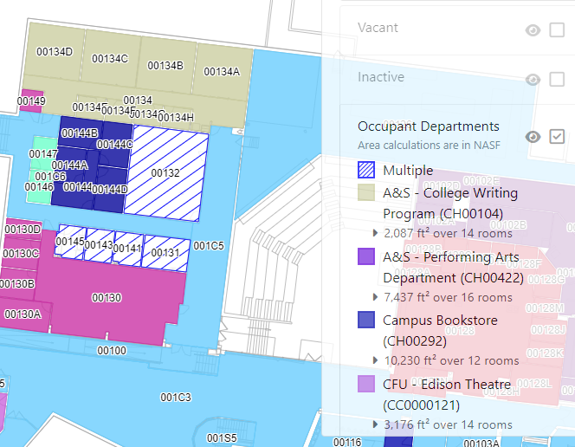
OSIS – Floorplans and Views
Review by Assignee Department
Review by Occupant Department

Slide 19
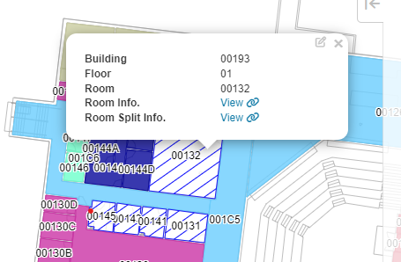
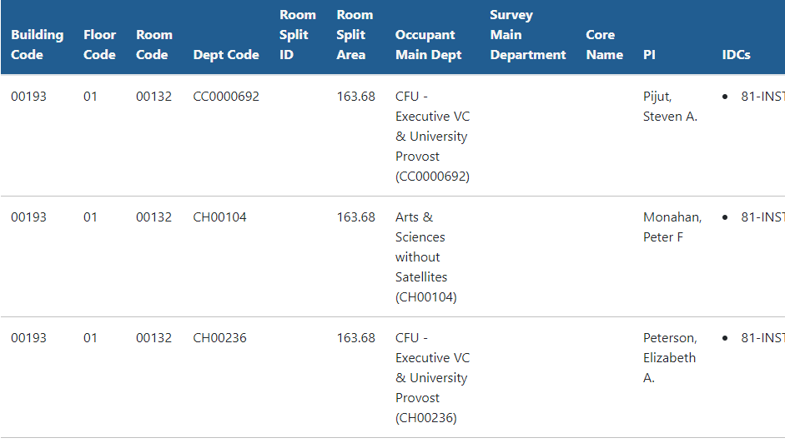
OSIS – Room/Room Split Info
Room Info
Selecting the Room Info view will give the most to date information of the Room.
Room Split Info.
Selecting the Room Split Info view will produce a list of the Department(s) Occupying the Room.

Slide 20
Review Space Utilization Reports

Slide 21
Review Buildings, Floors and Rooms for accuracy

Slide 22
Review Room Type for accuracy

Slide 23
Planning Survey – Request Room Update
Room Attributes that can be changed:
Room Type
- We have a list of available Room Types at
Space.Wustl.edu
- Some changes may need Committee approval
Assignee Department
Rooms are assigned to only one department
Rooms can be occupied by multiple departments
Please include a justification any time a Room Attribute is changed.
21

Slide 24
Review Room PI/PO

Slide 25
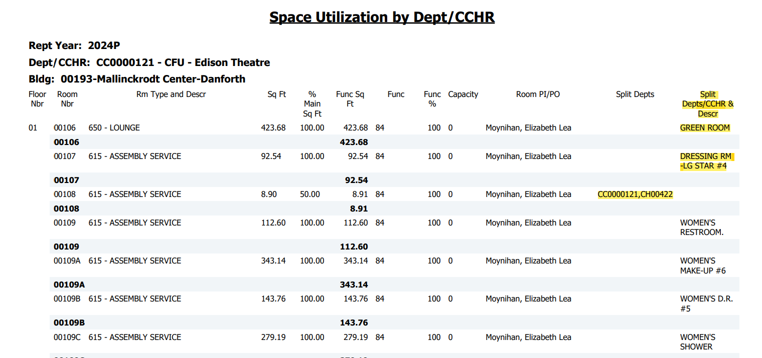
Add/Delete and Verify Room Splits

Slide 26
Planning Survey – Room Splits
Determine Room Splits by CC/CCH and Responsible party.
Room splits should be assigned to all CC/CCH physically occupying the space.
Review the CC/CCH assigned
Are they are still occupying the space? Or do they need to be updated?
11

Slide 27
Planning Survey – Date Effectives
Date Effective – the date in which a change to any or a combination of the following occurred:
Edit a Room Split
Responsible Party PI/PO
Department
Percentage (%) of Space
Add or Delete Room Split
Request Room Update
Effective dates for the splits need to be consistent with the date the change took place. We cannot back date prior to the most recent effective date.
20

Slide 28
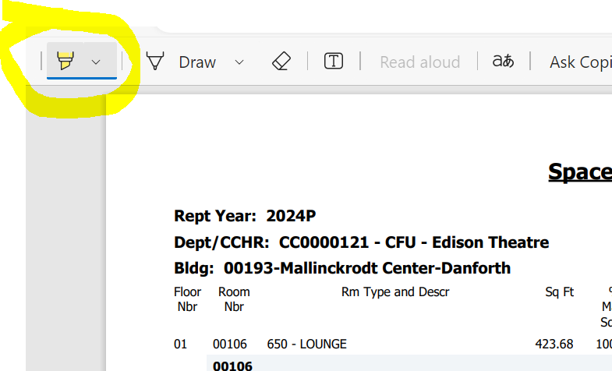
Revising Space Survey
Please ensure that all changes to the survey are highlighted when returning the Space Survey.
Select the highlight tool.
Make the necessary revisions then highlight the lines with space changes.

Slide 29
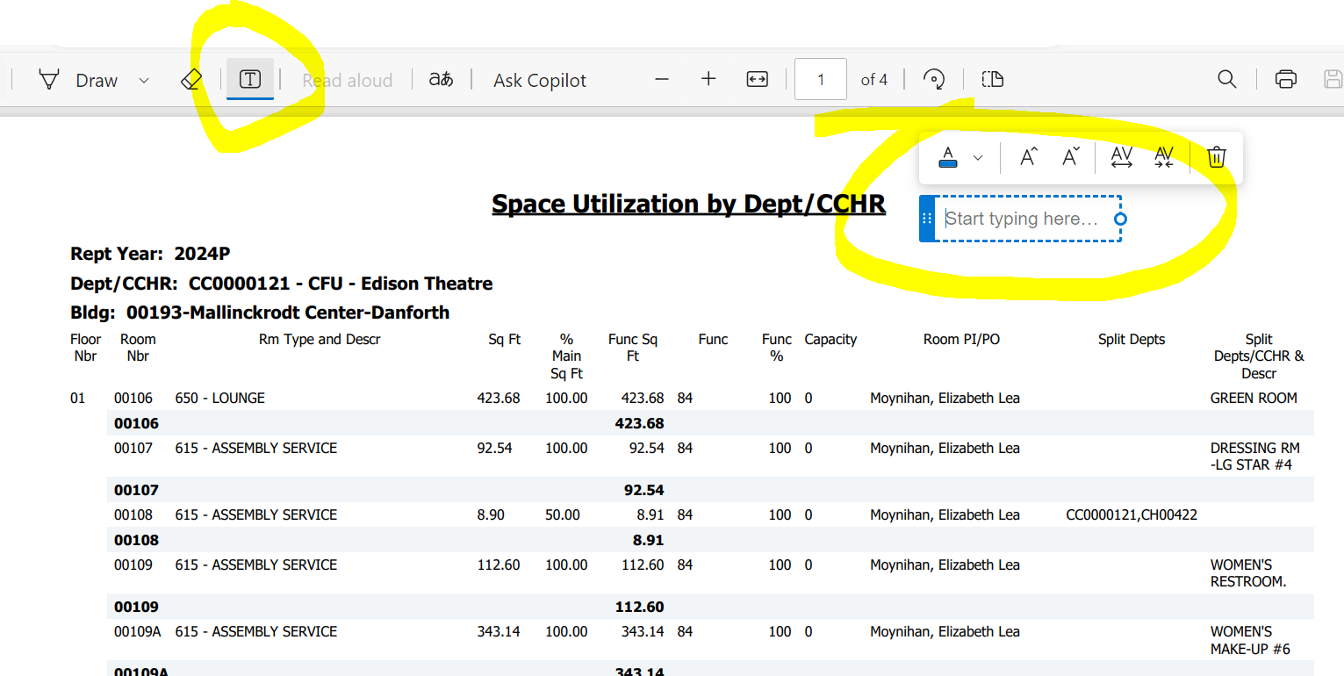
Add your signature, save and return to Erin Sweetman
For those using Adobe Pro, select the Add text box then Add name and date.

Slide 30
Sign final PDF reports
Please sign and date the final Space Utilization before the
May 12th deadline.

Slide 31
FY24 Survey Reminders
Review your Room Inventory reports and compare to OSIS floor plans for accuracy
Update any room split percentages
Walk your space to make sure occupants and room types are correct (we do a lot of moving & remodeling)
Send any updates to Erin Sweetman and your space will be revised. A final report will be sent after the Annual portion of the Survey has closed.
29

Slide 32
Questions?
If you need any help, please reach out to us. We are here to help in any way we can.
Scott Masterson – Manager, Indirect Cost
masterson@wustl.edu
Erin Sweetman – Space Coordinator
s.erin@wustl.edu
32

