Slide 1
FY 2024 Space Planning Training

Slide 2
The FY24 Space Team Members:
Danforth Campus:
Erin Sweetman
Space Utilization Coordinator
s.erin@wustl.edu
Jenn Lankford
Senior Indirect Cost Analyst
Tel. 314-935-5713
jennifer.lankford@wustl.edu
Scott Masterson
Manager of Cost Analysis
Tel. 314-935-4309
masterson@wustl.edu
Medical School Campus:
Cheryl Kilwin
Planner II
Tel. 314-362-8317
kilwinc@wustl.edu
Terrell Davis
Relocation Space Coordinator
Tel. 314-362-8146
davis.terrell@wustl.edu

Slide 3
Planning Survey
Important Dates:
The Planning Survey is Open now
Planning Survey Closes Friday May 31st
Annual Survey Opens approx June 7th
Annual Survey closes Friday July 12th
8

Slide 4
Planning Survey
Planning Survey Cycle Goals:
Confirm and Update Room Splits (Responsible Party, Department, Recharge Center, % of Space)
Request Room Updates
Use Effective Dates
Add Occupants to room splits
Create Service-Benefiting Room Relationships
Planning Survey data is ‘Annualized’ by the system and becomes the initial Annual Survey data
8
Notes:
Planning versus Annual.
The goals for the Planning survey are –
Confirm and update room splits for the responsible party, occupying department, recharge centers, and percentages of space.
Requesting room updates – this is the only time when you can request updates
You must use effective dates.
You should add occupants to splits
Create service/benefiting room relationships
This information will become the beginning data for the Annual survey and for the FY24 Planning survey.
The goal of the Annual survey is to functionalize the room splits by assigning Function codes.

Slide 5
Planning Survey - How to Start?
Review Floor Plans by visiting OSIS or within ManageSpace at the room level.
OSIS → https://osisreporting.wustl.edu/osis/app/1/
ManageSpace → My Rooms→ Floor Plan
11

Slide 6
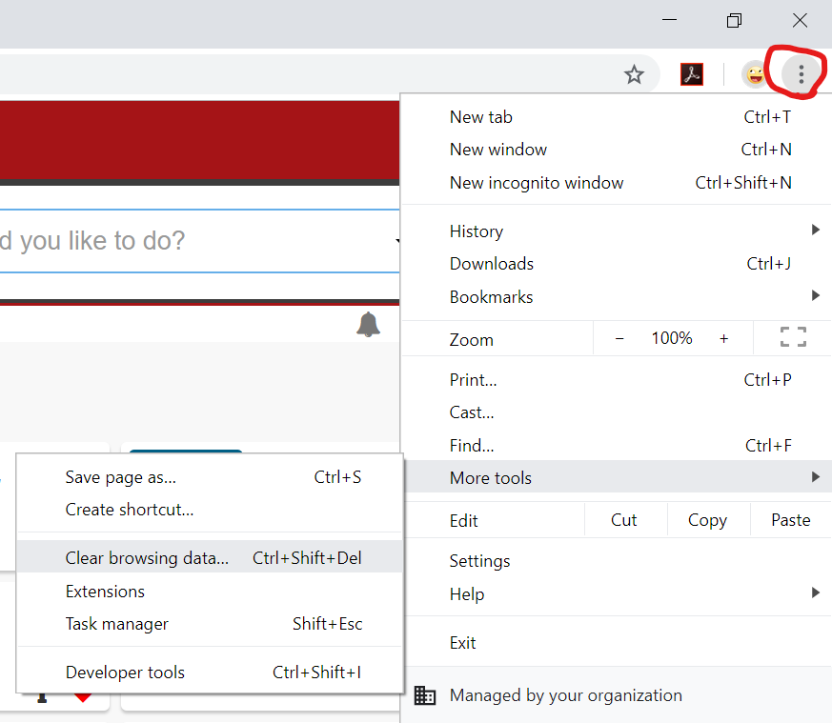
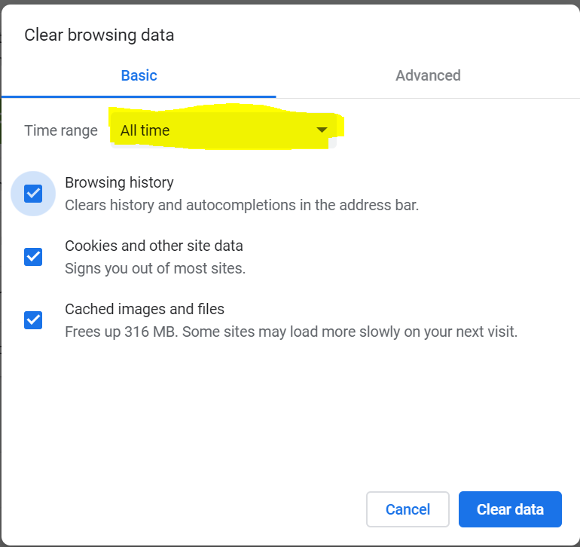
Clearing your Cache
You can clear your cache in Google Chrome by pressing Ctrl-Shift-Delete or by clicking the ellipses, selecting ‘More Tools’ and then ‘Clear Browsing History’
Select ‘All Time’ from the dropdown and click ‘Clear data’
12
Notes:
How to clear your Cache. You should clear your cache before beginning any Planning or Annual survey. To open the dialogue box, while in Google Chrome, you can either press CTRL-Shift-Delete or by clicking the ellipses at the top-right of the browser, selecting ‘More Tools, then select ‘Clear browsing data’. In the popup, select ‘All time’ from the drop down and ‘Browsing History, then select ‘Clear Data’

Slide 7
Access to ManageSpace
Using Google Chrome only, you can access ManageSpace a few different ways:
Typing the website directly into your google chrome search bar managespace.wustl.edu
Accessing it through One.wustl.edu → Search for ManageSpace
13
Notes:
How to logon to ManageSpace? You can access ManageSpace through one.wustl.edu or by typing managaespace.wustl.edu. You must only use Google Chrome and you will need to clear your cache for ‘All time’ before you start the survey.

Slide 8
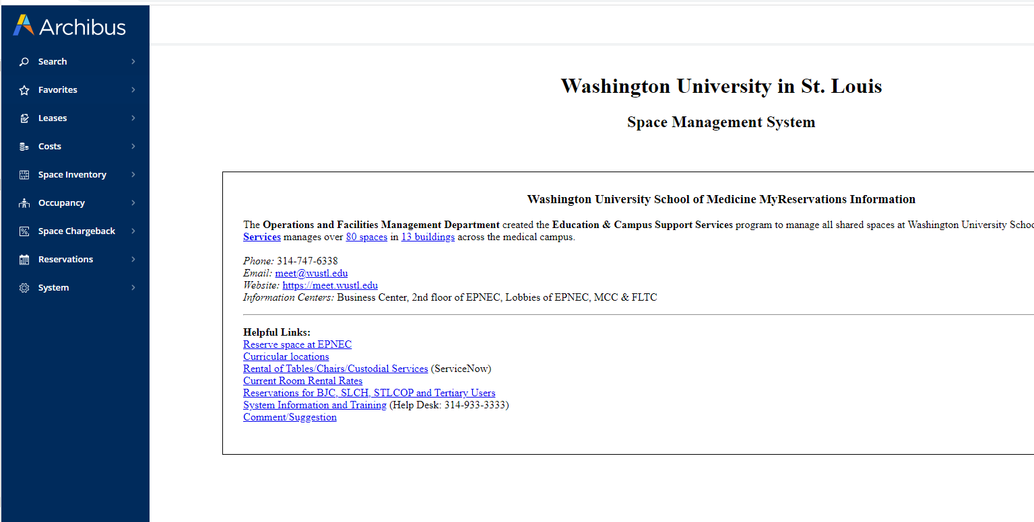
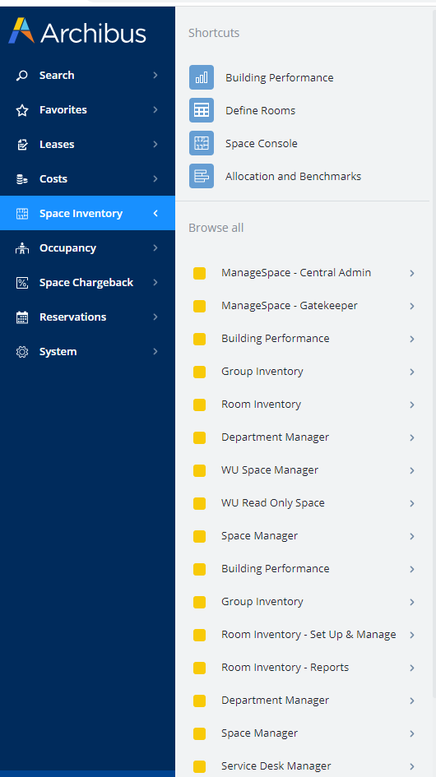
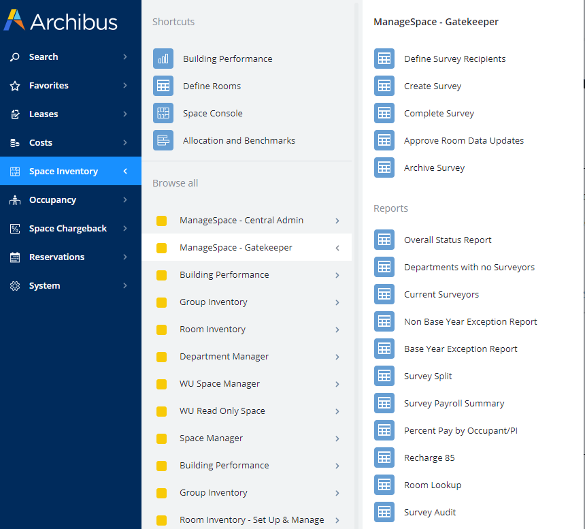
Navigating to the Survey
14
Notes:
Navigating to the survey. Depending on the amount of access that you have, you may see more or less options. From magangespace.wustl.edu choose ‘Space Inventory’, then ‘ManageSpace’, then ‘Complete Survey’.

Slide 9
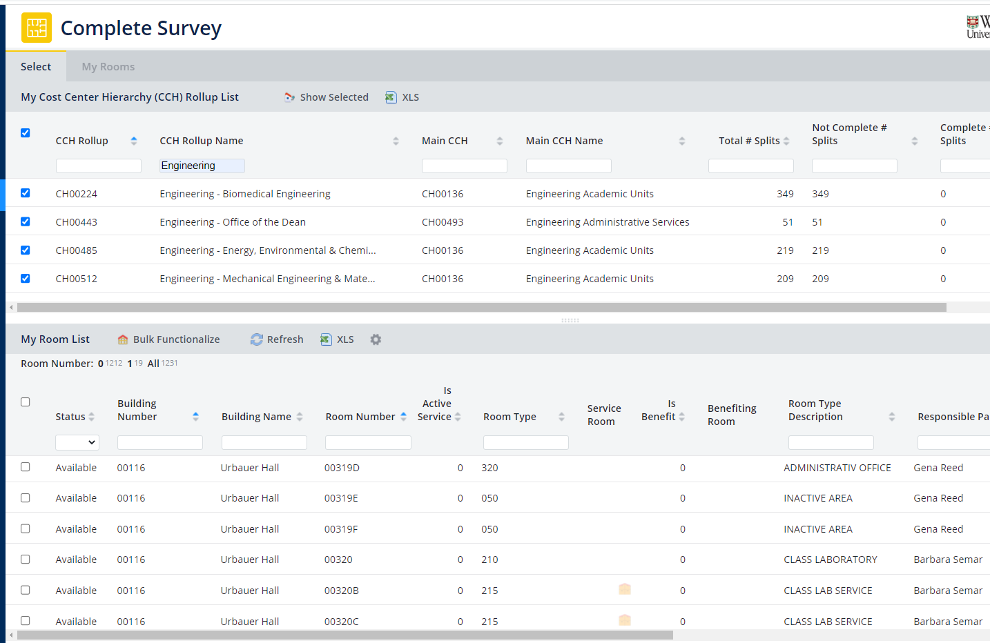
Planning Survey – Complete Survey
‘Complete Survey’ is where you do all of your updates to the survey. It’s two parts, My Cost Center Hierarchy (CCH) & My Rooms list, can be filtered, sorted & downloaded into Excel
Download for Excel
15
Notes:
Now that you have cleared your cache and logged in through Google Chrome, you can start working on the survey. You will use ‘Complete Survey’ to all of your updates. This has two parts ‘My Department list’ and ‘My Room List’. These two panels can be filtered, sorted, and downloaded into Excel. Any place you see the XLS icon you can down load the current panel into Excel

Slide 10
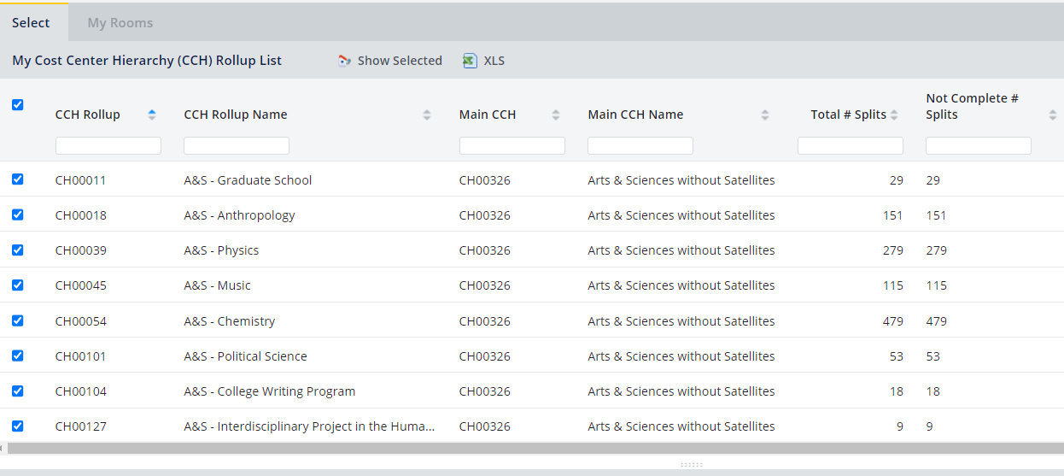
Planning Survey – My Cost Center Hierarchy (CCH) Rollup List
This panel will list the CC/CCH that have splits that you need to survey, the number of splits in a CC/CCH, and the percentage of splits that you have completed.
Check the CC/CCH you wish to see and click ‘Show Selected’
The Room List will not update until you click ‘Show Selected’ or select a department with the ‘hand’ cursor.
16
Notes:
My Department List is a list of departments that you can access. You can check the departments that you want to view and either click ‘Show Selected’ or click a department when the cursor is a ‘Hand’. The ‘My Rooms’ panel will not update until you do one or the other

Slide 11
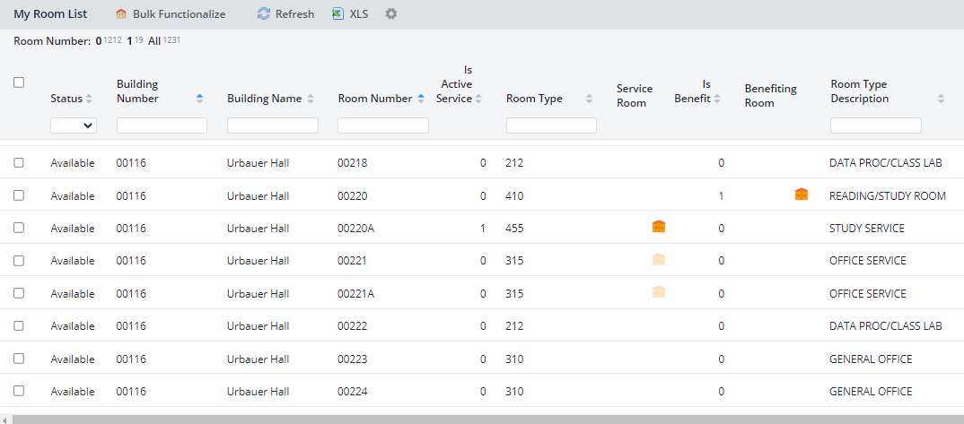
Planning Survey – My Rooms List
This is a list of rooms that you can access that are in the CC/CCH you selected in the My CCH Rollup list.
You will only see rooms that are in selected CC/CCH.
Select rooms to Bulk Functionalize
Updates this panel
Click with the ‘Hand’ to open the ‘Room Splits’
You can change the order of the columns
We also recommend you download the My rooms list into excel so you can mark rooms down as you complete them so you can keep track of what you have done.
17

Slide 12
Planning Survey – Rooms Splits Icons
Takes you back to the My Departments/My Rooms Panel Tab
Opens the floor plan window
Opens the request room update dialog box
Goes to the previous room – any filtering will be in place
Goes to the next room – any filtering will be in place
Deletes split Edits Split Completes the split Add a split
Opens a dialogue box displaying split currently and at the beginning of FY23
Shows the history of the room
Opens the ‘Occupant’ Panel
18

Slide 13
Occupant Panel
Clicking with the ‘hand’ cursor over the “Available Status” will open the ‘Occupant’ panel that provides a list of the current occupants of a split. You can add/remove occupants as well as Set Current and Copy. There is no need to further functionalize splits during in the Planning Survey.
Downloads the selected occupant list to excel
Sets the occupant to Current or Non-Current
Copies the checked occupants to eligible splits
Returns the occupants in the split back how they were at the beginning of the survey
Opens a dialogue box with a list of occupants for the split
Removes selected occupants from the split
Next will advance the tab to the right
19

Slide 14
Planning Survey – Effective Date
Effective Date– the date in which a change to any or a combination of the following occurred:
Edit a Room Split
Responsible Party – not the occupant
Department
Recharge Center
Percentage (%) of Space
Add or Delete Room Split
Request Room Update
Bulk Functionalization
Effective dates for the splits need to be consistent between the splits and a surveyor cannot back date prior to the most recent effective date
20

Slide 15
Planning Survey – Date Effectives
Effective Date Example:
Looking at the last two rows of this particular room record, you can see that on 12/1/2022 a new department and responsible party took over occupying the space. The last record is the most up to date record for the room.

Slide 16
Planning Survey – Request Room Update
Room Attributes that can be changed:
Room Type
Changes to Room Type may require committee approval
Assignee Department
Rooms are assigned to only one department
Rooms can be occupied by multiple departments
Lab Quality Code
Room is locked in “Submitted-Pending Approval” status until the Requested Room Update is approved or denied by IDC.
Please include any necessary information in the justification window
21

Slide 17
Recharge Centers
Each Recharge Center needs to assign space where the recharge center’s activity for the product/service takes place
Recharge Centers are assigned a unique cost center and are manually attached to the room split(s) where the recharge activities take place.
To add the recharge center cost center to a split, click on the “Edit” pencil.
At the pop up box, search for the unique cost center in the Recharge Center Box.
22

Slide 18
Optional Feature – Service Benefitting Rooms
Service Rooms are rooms that provide support or service to other rooms
Benefiting Rooms are rooms that benefit or use the services of a service room
Service and Benefiting rooms are identified by the small house icon on the My Room List
Service Room with at least one benefitting room
Service Room Eligible
23

Slide 19
Service Room Eligibility
A room is eligible as a Service Room if all of the following criteria are met:
1. No Recharge Center is assigned to the room
Room is not a ‘Benefitting Room to another ‘Service Room’
Room Type is one of the following:
115, 125
215, 225, 235, 253, 254, 255, 256, 257, 258, 259, 260
315, 325, 335, 345, 355
455
515, 525, 535, 555, 575, 579, 585
615, 625, 635, 645, 655, 665, 675, 685
715, 725, 735, 745, 750, 765
815, 835, 845, 855, 885, 895
935, 955
24

Slide 20
Service Rooms: when NOT to Use
DO NOT USE Service Room Feature if either of the following apply:
You do not want ‘Service Room’ Split based on the weighted average of total ASF of the ‘Benefiting Rooms’ assigned
Instead, manually create room splits by Responsible Party, Department, Recharge Center and % of Space as you would any other room
You have a Benefiting room with Inactive Space
(IDC Function Code 93)
25

Slide 21
Service Room Continued
*During Planning Survey, create the service-benefiting relationships. Night time process runs during Annual Survey and creates Service Room splits once all Benefiting Rooms are Marked Completed in the Annual Survey.
Benefiting Room 1 250 ASF
Split 1 250 ASF IDC 82 100% CH1234 Curie
System will split service room based on total ASF average by CH/Resp Party/ Recharge of attached benefiting room(s)
Benefiting Room 2 500 ASF
Split 1 250 ASF IDC 84 100% CH4567 Curie
Split 2 250 ASF IDC 83 100% CH3999 Einstein
Benefiting Room 3 250 ASF
Split 1 RCtr 100 ASF IDC 85 100% CH2478 Salk
Split 2 150 ASF IDC 81 100% CH2478 Salk
During Planning – Service Room runs at the beginning of the month.
During Annual – The Service Room process runs nightly.
Service Room Splits that Appear after Night Time Process
Split 1 25% Space IDC 82 100% CH1234 Curie
Split 2 25% Space IDC 84 100% CH4567 Curie
Split 3 25% Space IDC 83 100% CH3999 Einstein
Split 4 10% Space RCtr IDC 85 100% CH2478 Salk
Split 5 15% Space IDC 81 100% CH2478 Salk
26
Notes:
Service/Benefitting runs daily during Annual and at the beginning of each month in Planning.

Slide 22
Service Benefitting Rooms Continued
Examples on how to set up this optional feature will be provided to surveyors.
This feature is not required. If your department chooses not to use, that is OK.
27

Slide 23
One Last Tip for Planning
During Planning – Rooms start in the available status. After you make a chance and click “Mark Complete”, rooms will not change status, it will stay in Available. We understand this causes lots of confusion. Click back on the room after changes are made, if the changes are correct, you can move on to the next room.
28

Slide 24
FY24 Planning Survey Reminders
Add Recharge Center Key to room split
Add Occupants to room splits
This will save you lots of work during the annual portion.
Edit any room splits that need updating
Create Service Benefitting Relationships (optional)
Ask questions if you don’t understand
Complete all room splits that are in Incomplete or Pending status by the end of planning on May 31st. You will lose all edits and will need to duplicate your work when FY25 Planning opens if this is not done by the deadline.
29

Slide 25
Appendix

Slide 26
ManageSpace: FY24P Examples
Example A – Request Room Update New Room Type, Assignee Dept, or Lab Quality Code needs changed Effective Date of the requested change | Example B – Room Split Edit Using Date Effective Show History
Example C – Room Split Deletion Using Date Effective | Example D – Service Rooms Adding and deleting service rooms
Example E – Recharge Center Activity Adding Recharge Key to a room split

Slide 27
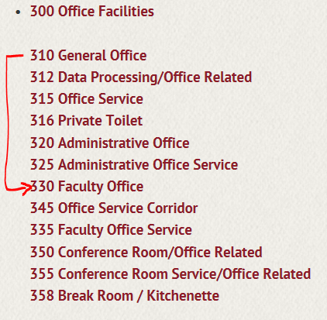
FY24P Example A – Request Room Update
My Cost Center Hierarchy (CCH) Rollup List→ My Room List → Select Room
Request Room Update Button is displayed in the Room Header
Request Room Update changes will apply to the room as a whole.
Currently the Room Type for the room is 310 – General Office
I would like to change the Room Type from 310 – General Office
to 330 – Faculty Office
Room Type Codes can be found at space.wustl.edu → Room Type Code Definitions

Slide 28
FY24P Example A – Request Room Update
Click on the button.
Room Update Request Screen appears
Select “330” as the New Room Type
Enter a Justification for the requested room update
Effective Date
… unlikely to be the same date that the room request update is submitted
… should be the date that the Room Type changed from 310 to 330

Slide 29
FY24P Example A – Request Room Update
Effective Date … modified to be the date that the Room Type Changed (beginning of FY22, 7/1/2021)
Press the button
Once a Request Room Update has been submitted, the room status changes to Submitted-Pending Approval
Delete, Edit, Mark Completed, and Add Split buttons will be disabled until the Request Room Update is approved or rejected
Notes:
Room Split status for each record will be set to Available/Original—Any room split edits must be marked complete to be saved by May 31st
Room splits in an Incomplete or Pending status at the end of day on May 31st will automatically loose all edits to the room splits. They will not be saved.
Users will be required to update FY23 Survey and FY24P to correct your planning date.
Planning data must be Available and Original by May 31st, if you have outstanding records by May 31st, we will delete that edit and your planning data will be inaccurate. FY23 Survey will need to be updated and FY24P planning will also need updated.
Service room relationships to benefiting rooms will be retained
Overnight process will automatically split service room
It will NOT functionalize the service room in Space Planning.
IT WILL mark complete overnight and push to planning any edits you may have made to the benefiting rooms or relationship
Be sure to plan if you want to bulk functional during planning. – You can use bulk to just update Dept/RP : You will only need to do this if the activities room changed and the function will not be retained for FY23 Survey.

Slide 30
FY24P Example A – Request Room Update
Request Room Update was Approved
Room Type is updated to 330
Justification entered appears in the Comments section of the Room Header
Clicking on the button shows the Room History transactions
Notice that the Start Date of 7/1/2021 is the same as the Effective Date Entered in the Request Room Update
There is no End Date because the requested change is the most current
Notice the Room Type change from 310 to 330 for each room split in the room

Slide 31
FY24P Example A – Request Room Update
I forgot to request an update for the Assignee Department change
from CH00054 A&S - Chemistry
to CH00413 Accounting Services
Another Request Room Update needs to be submitted.
Multiple changes can be submitted on the same Request Room Update as long as they all have the same Effective Date
Select “CH00413” as the New Assignee CCH
Enter a Justification for the requested room update
Effective Date … what is going to happen with an Effective Date of 7/1/2021 submitted?
Notes:
Room Split status for each record will be set to Available/Original—Any room split edits must be marked complete to be saved by May 31st
Room splits in an Incomplete or Pending status at the end of day on May 31st will automatically loose all edits to the room splits. They will not be saved.
Users will be required to update FY23 Survey and FY24P to correct your planning date.
Planning data must be Available and Original by May 31st, if you have outstanding records by May 31st, we will delete that edit and your planning data will be inaccurate. FY23 Survey will need to be updated and FY24P planning will also need updated.
Service room relationships to benefiting rooms will be retained
Overnight process will automatically split service room
It will NOT functionalize the service room in Space Planning.
IT WILL mark complete overnight and push to planning any edits you may have made to the benefiting rooms or relationship
Be sure to plan if you want to bulk functional during planning. – You can use bulk to just update Dept/RP : You will only need to do this if the activities room changed and the function will not be retained for FY23 Survey.

Slide 32
FY24P Example A – Request Room Update
Error Message received …
… WHY?
Because of the previous Request Room Update transaction.
Notes:
Room Split status for each record will be set to Available/Original—Any room split edits must be marked complete to be saved by May 31st
Room splits in an Incomplete or Pending status at the end of day on May 31st will automatically loose all edits to the room splits. They will not be saved.
Users will be required to update FY23 Survey and FY24P to correct your planning date.
Planning data must be Available and Original by May 31st, if you have outstanding records by May 31st, we will delete that edit and your planning data will be inaccurate. FY23 Survey will need to be updated and FY24P planning will also need updated.
Service room relationships to benefiting rooms will be retained
Overnight process will automatically split service room
It will NOT functionalize the service room in Space Planning.
IT WILL mark complete overnight and push to planning any edits you may have made to the benefiting rooms or relationship
Be sure to plan if you want to bulk functional during planning. – You can use bulk to just update Dept/RP : You will only need to do this if the activities room changed and the function will not be retained for FY23 Survey.

Slide 33
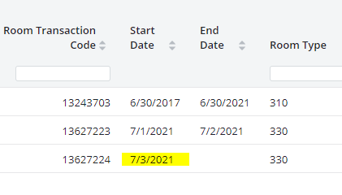
FY24P Example A – Request Room Update
Change the Effective Date to 7/3/2021 or after … and press the button
Room History will show new Start Date
Request Room Update was approved and the Assignee Department has now changed to CH00413
But wait ….. Why did the Assignee CCH Rollup # not overwrite the Room Split / Occupying CCH rollup #’s?

Slide 34
FY24P Example A – Request Room Update
But wait ….. Why did the Assignee CCH rollup # not overwrite the Room Split / Occupying CCH #’s?
Because a Room can be Assigned to a CCH/CC (CH00413 for example) and occupied but different departments (CH00054 in this case). This is how the system was designed to work.
But I really want one of the occupying departments to be the same as the Assignee Department …..
….. then you will need to Edit the Department Number for each room split.
Notes:
Room Split status for each record will be set to Available/Original—Any room split edits must be marked complete to be saved by May 31st
Room splits in an Incomplete or Pending status at the end of day on May 31st will automatically loose all edits to the room splits. They will not be saved.
Users will be required to update FY23 Survey and FY24P to correct your planning date.
Planning data must be Available and Original by May 31st, if you have outstanding records by May 31st, we will delete that edit and your planning data will be inaccurate. FY23 Survey will need to be updated and FY24P planning will also need updated.
Service room relationships to benefiting rooms will be retained
Overnight process will automatically split service room
It will NOT functionalize the service room in Space Planning.
IT WILL mark complete overnight and push to planning any edits you may have made to the benefiting rooms or relationship
Be sure to plan if you want to bulk functional during planning. – You can use bulk to just update Dept/RP : You will only need to do this if the activities room changed and the function will not be retained for FY23 Survey.

Slide 35
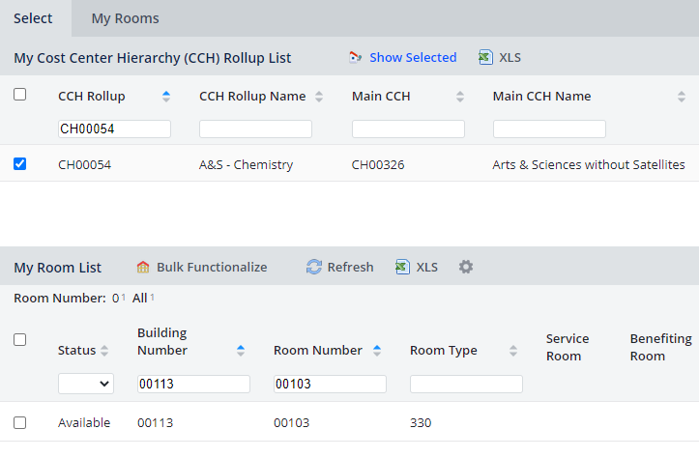
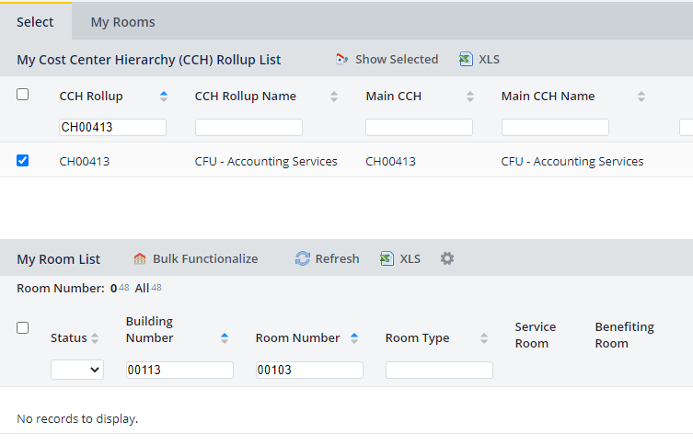
FY24P Example B – Room Split Edit
Before we modify the room split / occupying department numbers for Room 202B, let’s discuss which department(s) will see the room in their My Room List.
My CCH Rollup list→ “CH00413” CCH Rollup filter
My Room List → “00103” Room filter
My CCH Rollup list→ “CH00054” Dept filter
My Room List → “00103” Room filter
The My Room List populates with the Rooms based on the Room Split CC/CCH #
Since the room split has the Occupying CH of CH00054 A&S Chemistry, when I search for the room under CH00413 CFU Accounting Services I will not see the room in My Room List
Notes:
Room Split status for each record will be set to Available/Original—Any room split edits must be marked complete to be saved by May 31st
Room splits in an Incomplete or Pending status at the end of day on May 31st will automatically loose all edits to the room splits. They will not be saved.
Users will be required to update FY23 Survey and FY24P to correct your planning date.
Planning data must be Available and Original by May 31st, if you have outstanding records by May 31st, we will delete that edit and your planning data will be inaccurate. FY23 Survey will need to be updated and FY24P planning will also need updated.
Service room relationships to benefiting rooms will be retained
Overnight process will automatically split service room
It will NOT functionalize the service room in Space Planning.
IT WILL mark complete overnight and push to planning any edits you may have made to the benefiting rooms or relationship
Be sure to plan if you want to bulk functional during planning. – You can use bulk to just update Dept/RP : You will only need to do this if the activities room changed and the function will not be retained for FY23 Survey.

Slide 36
FY24P Example B – Room Split Edit
Steps to edit a room split / occupying CCH rolllup from CH00054 Chemistry to CH00413 Accounting Services
Click on the pencil icon in the split
Press the button.
Notes:
Room Split status for each record will be set to Available/Original—Any room split edits must be marked complete to be saved by May 31st
Room splits in an Incomplete or Pending status at the end of day on May 31st will automatically loose all edits to the room splits. They will not be saved.
Users will be required to update FY23 Survey and FY24P to correct your planning date.
Planning data must be Available and Original by May 31st, if you have outstanding records by May 31st, we will delete that edit and your planning data will be inaccurate. FY23 Survey will need to be updated and FY24P planning will also need updated.
Service room relationships to benefiting rooms will be retained
Overnight process will automatically split service room
It will NOT functionalize the service room in Space Planning.
IT WILL mark complete overnight and push to planning any edits you may have made to the benefiting rooms or relationship
Be sure to plan if you want to bulk functional during planning. – You can use bulk to just update Dept/RP : You will only need to do this if the activities room changed and the function will not be retained for FY23 Survey.

Slide 37
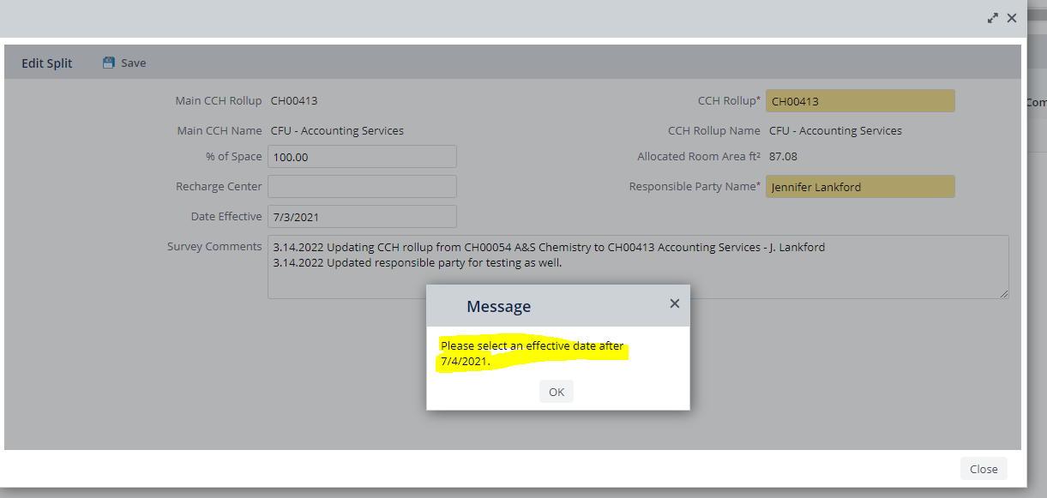
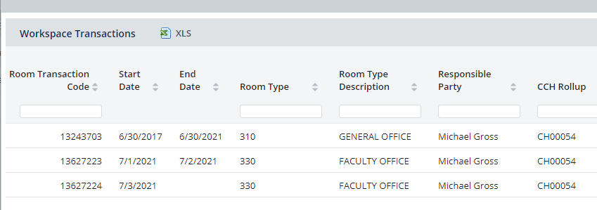
FY24P Example B – Room Split Edit
Error Message received …
… WHY?
Because of the existing Room History transactions.
Change the Date to 7/5/2021 or after
Press the Save button
If I click on Show History button I should see the Saved Transaction right?
No, the room has to be Marked Completed first
Notes:
Room Split status for each record will be set to Available/Original—Any room split edits must be marked complete to be saved by May 31st
Room splits in an Incomplete or Pending status at the end of day on May 31st will automatically loose all edits to the room splits. They will not be saved.
Users will be required to update FY23 Survey and FY24P to correct your planning date.
Planning data must be Available and Original by May 31st, if you have outstanding records by May 31st, we will delete that edit and your planning data will be inaccurate. FY23 Survey will need to be updated and FY24P planning will also need updated.
Service room relationships to benefiting rooms will be retained
Overnight process will automatically split service room
It will NOT functionalize the service room in Space Planning.
IT WILL mark complete overnight and push to planning any edits you may have made to the benefiting rooms or relationship
Be sure to plan if you want to bulk functional during planning. – You can use bulk to just update Dept/RP : You will only need to do this if the activities room changed and the function will not be retained for FY23 Survey.

Slide 38
FY24P Example B – Room Split Edit
Press the button
Click the Yes button
The following message appears:
Click the Yes button
Now the Show History contains the following transactions
Notes:
Room Split status for each record will be set to Available/Original—Any room split edits must be marked complete to be saved by May 31st
Room splits in an Incomplete or Pending status at the end of day on May 31st will automatically loose all edits to the room splits. They will not be saved.
Users will be required to update FY23 Survey and FY24P to correct your planning date.
Planning data must be Available and Original by May 31st, if you have outstanding records by May 31st, we will delete that edit and your planning data will be inaccurate. FY23 Survey will need to be updated and FY24P planning will also need updated.
Service room relationships to benefiting rooms will be retained
Overnight process will automatically split service room
It will NOT functionalize the service room in Space Planning.
IT WILL mark complete overnight and push to planning any edits you may have made to the benefiting rooms or relationship
Be sure to plan if you want to bulk functional during planning. – You can use bulk to just update Dept/RP : You will only need to do this if the activities room changed and the function will not be retained for FY23 Survey.

Slide 39
FY24P Example B – Room Split Edit
Date Effective is required when Editing a Room Split in the following situations:
Responsible Party Changes
Department Changes
% of Space Changes
Recharge Center key is added/removed
Date Effective is also required when Deleting a Room Split
Notes:
Room Split status for each record will be set to Available/Original—Any room split edits must be marked complete to be saved by May 31st
Room splits in an Incomplete or Pending status at the end of day on May 31st will automatically loose all edits to the room splits. They will not be saved.
Users will be required to update FY23 Survey and FY24P to correct your planning date.
Planning data must be Available and Original by May 31st, if you have outstanding records by May 31st, we will delete that edit and your planning data will be inaccurate. FY23 Survey will need to be updated and FY24P planning will also need updated.
Service room relationships to benefiting rooms will be retained
Overnight process will automatically split service room
It will NOT functionalize the service room in Space Planning.
IT WILL mark complete overnight and push to planning any edits you may have made to the benefiting rooms or relationship
Be sure to plan if you want to bulk functional during planning. – You can use bulk to just update Dept/RP : You will only need to do this if the activities room changed and the function will not be retained for FY23 Survey.

Slide 40
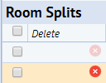
FY24P Example C – Room Split Deletion
I would like to delete the room split with CH01098 and only keep the room split with CH00547
Click on the button of the room split that needs deleted
The following message appears:
Click the Yes button
In order to delete an existing room split, the Date Effective must be entered and the % of Space must be set to 0 %.
Notes:
Room Split status for each record will be set to Available/Original—Any room split edits must be marked complete to be saved by May 31st
Room splits in an Incomplete or Pending status at the end of day on May 31st will automatically loose all edits to the room splits. They will not be saved.
Users will be required to update FY23 Survey and FY24P to correct your planning date.
Planning data must be Available and Original by May 31st, if you have outstanding records by May 31st, we will delete that edit and your planning data will be inaccurate. FY23 Survey will need to be updated and FY24P planning will also need updated.
Service room relationships to benefiting rooms will be retained
Overnight process will automatically split service room
It will NOT functionalize the service room in Space Planning.
IT WILL mark complete overnight and push to planning any edits you may have made to the benefiting rooms or relationship
Be sure to plan if you want to bulk functional during planning. – You can use bulk to just update Dept/RP : You will only need to do this if the activities room changed and the function will not be retained for FY23 Survey.

Slide 41
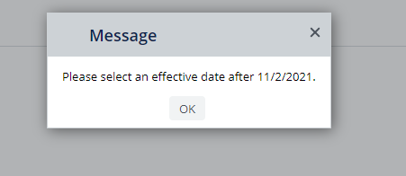
FY24P Example C – Room Split Deletion
Enter 0.00 as the % of Space
Enter Survey Comments for the deletion
(not required but definitely helpful when reviewing Cognos report)
Effective Date … what is going to happen with an Effective Date of 11/1/2021 saved? It automatically defaults to the last date effective in the system. Let’s see what happens if we leave it as it populates.
Click Save
Notes:
Room Split status for each record will be set to Available/Original—Any room split edits must be marked complete to be saved by May 31st
Room splits in an Incomplete or Pending status at the end of day on May 31st will automatically loose all edits to the room splits. They will not be saved.
Users will be required to update FY23 Survey and FY24P to correct your planning date.
Planning data must be Available and Original by May 31st, if you have outstanding records by May 31st, we will delete that edit and your planning data will be inaccurate. FY23 Survey will need to be updated and FY24P planning will also need updated.
Service room relationships to benefiting rooms will be retained
Overnight process will automatically split service room
It will NOT functionalize the service room in Space Planning.
IT WILL mark complete overnight and push to planning any edits you may have made to the benefiting rooms or relationship
Be sure to plan if you want to bulk functional during planning. – You can use bulk to just update Dept/RP : You will only need to do this if the activities room changed and the function will not be retained for FY23 Survey.

Slide 42
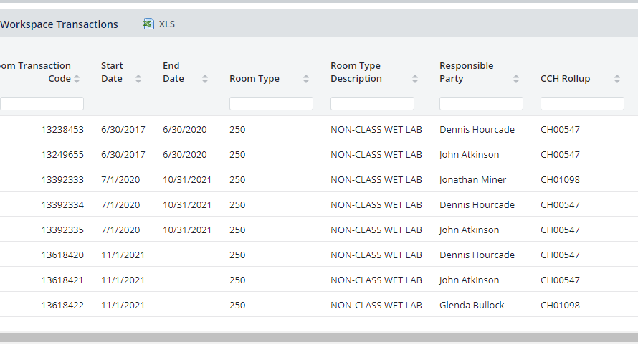
FY24P Example C – Room Split Deletion
Remember check the Room History transactions for effective dates.
The Start Date for the most recent transaction for the split that I am trying to delete is 11/1/2021.
A valid End Date is 11/2/2021 or after ….
…. which means that the Date Effective for deletion needs to be 11/3/2021 or after.
Click the Save button
Notes:
Room Split status for each record will be set to Available/Original—Any room split edits must be marked complete to be saved by May 31st
Room splits in an Incomplete or Pending status at the end of day on May 31st will automatically loose all edits to the room splits. They will not be saved.
Users will be required to update FY23 Survey and FY24P to correct your planning date.
Planning data must be Available and Original by May 31st, if you have outstanding records by May 31st, we will delete that edit and your planning data will be inaccurate. FY23 Survey will need to be updated and FY24P planning will also need updated.
Service room relationships to benefiting rooms will be retained
Overnight process will automatically split service room
It will NOT functionalize the service room in Space Planning.
IT WILL mark complete overnight and push to planning any edits you may have made to the benefiting rooms or relationship
Be sure to plan if you want to bulk functional during planning. – You can use bulk to just update Dept/RP : You will only need to do this if the activities room changed and the function will not be retained for FY23 Survey.

Slide 43
FY24P Example C – Room Split Deletion
If I click on Show History button I should see the Saved Transaction right?
No, the room has to be Marked Completed first
In order to Mark Completed, the % of Space must sum to 100%
Notes:
Room Split status for each record will be set to Available/Original—Any room split edits must be marked complete to be saved by May 31st
Room splits in an Incomplete or Pending status at the end of day on May 31st will automatically loose all edits to the room splits. They will not be saved.
Users will be required to update FY23 Survey and FY24P to correct your planning date.
Planning data must be Available and Original by May 31st, if you have outstanding records by May 31st, we will delete that edit and your planning data will be inaccurate. FY23 Survey will need to be updated and FY24P planning will also need updated.
Service room relationships to benefiting rooms will be retained
Overnight process will automatically split service room
It will NOT functionalize the service room in Space Planning.
IT WILL mark complete overnight and push to planning any edits you may have made to the benefiting rooms or relationship
Be sure to plan if you want to bulk functional during planning. – You can use bulk to just update Dept/RP : You will only need to do this if the activities room changed and the function will not be retained for FY23 Survey.

Slide 44
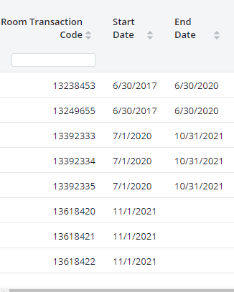
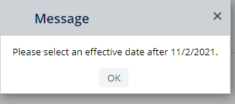
FY24P Example C – Room Split Deletion
Edit the room split that I want to keep to have 100.00 % of Space
Originally the split had 33% of Space assigned to CH01098.
We want to go ahead and change all the splits to CH00547.
Enter 100.00 as the % of Space
Enter Survey Comments for the update
(not required but definitely helpful when reviewing Cognos report)
Effective Date … what is going to happen with an Effective Date of 11/1/2021 saved?
Click Save
Notes:
Room Split status for each record will be set to Available/Original—Any room split edits must be marked complete to be saved by May 31st
Room splits in an Incomplete or Pending status at the end of day on May 31st will automatically loose all edits to the room splits. They will not be saved.
Users will be required to update FY23 Survey and FY24P to correct your planning date.
Planning data must be Available and Original by May 31st, if you have outstanding records by May 31st, we will delete that edit and your planning data will be inaccurate. FY23 Survey will need to be updated and FY24P planning will also need updated.
Service room relationships to benefiting rooms will be retained
Overnight process will automatically split service room
It will NOT functionalize the service room in Space Planning.
IT WILL mark complete overnight and push to planning any edits you may have made to the benefiting rooms or relationship
Be sure to plan if you want to bulk functional during planning. – You can use bulk to just update Dept/RP : You will only need to do this if the activities room changed and the function will not be retained for FY23 Survey.

Slide 45
FY24P Example C – Room Split Deletion
Change Date Effective to be 11/3/2021
Click the Save button
The splits are saved now ….
….. but, the split that I want to delete is still showing up …
Notes:
Room Split status for each record will be set to Available/Original—Any room split edits must be marked complete to be saved by May 31st
Room splits in an Incomplete or Pending status at the end of day on May 31st will automatically loose all edits to the room splits. They will not be saved.
Users will be required to update FY23 Survey and FY24P to correct your planning date.
Planning data must be Available and Original by May 31st, if you have outstanding records by May 31st, we will delete that edit and your planning data will be inaccurate. FY23 Survey will need to be updated and FY24P planning will also need updated.
Service room relationships to benefiting rooms will be retained
Overnight process will automatically split service room
It will NOT functionalize the service room in Space Planning.
IT WILL mark complete overnight and push to planning any edits you may have made to the benefiting rooms or relationship
Be sure to plan if you want to bulk functional during planning. – You can use bulk to just update Dept/RP : You will only need to do this if the activities room changed and the function will not be retained for FY23 Survey.

Slide 46
FY24P Example C – Room Split Deletion
I expected it to disappear, why is it still there?!?!?!?
Because the room has to be Marked Completed
Press the button
Click the Yes button
Notes:
Room Split status for each record will be set to Available/Original—Any room split edits must be marked complete to be saved by May 31st
Room splits in an Incomplete or Pending status at the end of day on May 31st will automatically loose all edits to the room splits. They will not be saved.
Users will be required to update FY23 Survey and FY24P to correct your planning date.
Planning data must be Available and Original by May 31st, if you have outstanding records by May 31st, we will delete that edit and your planning data will be inaccurate. FY23 Survey will need to be updated and FY24P planning will also need updated.
Service room relationships to benefiting rooms will be retained
Overnight process will automatically split service room
It will NOT functionalize the service room in Space Planning.
IT WILL mark complete overnight and push to planning any edits you may have made to the benefiting rooms or relationship
Be sure to plan if you want to bulk functional during planning. – You can use bulk to just update Dept/RP : You will only need to do this if the activities room changed and the function will not be retained for FY23 Survey.

Slide 47
FY24P Example C – Room Split Deletion
But wait, why didn’t the other split for CH00547 disappear since it was saved to 0%? If you do not use the delete button and follow the previous steps and simply change the % of space to 0, it will remain on the split. So in order to get one line item for CH00547, we need to repeat the steps to delete the 0% of space.
Notes:
Room Split status for each record will be set to Available/Original—Any room split edits must be marked complete to be saved by May 31st
Room splits in an Incomplete or Pending status at the end of day on May 31st will automatically loose all edits to the room splits. They will not be saved.
Users will be required to update FY23 Survey and FY24P to correct your planning date.
Planning data must be Available and Original by May 31st, if you have outstanding records by May 31st, we will delete that edit and your planning data will be inaccurate. FY23 Survey will need to be updated and FY24P planning will also need updated.
Service room relationships to benefiting rooms will be retained
Overnight process will automatically split service room
It will NOT functionalize the service room in Space Planning.
IT WILL mark complete overnight and push to planning any edits you may have made to the benefiting rooms or relationship
Be sure to plan if you want to bulk functional during planning. – You can use bulk to just update Dept/RP : You will only need to do this if the activities room changed and the function will not be retained for FY23 Survey.

Slide 48
FY24P Example C – Room Split Deletion
Click the red X button on the 0% of space line and click delete
Click Mark Complete
Hurray, we are down to only one split for CH00547
Notes:
Room Split status for each record will be set to Available/Original—Any room split edits must be marked complete to be saved by May 31st
Room splits in an Incomplete or Pending status at the end of day on May 31st will automatically loose all edits to the room splits. They will not be saved.
Users will be required to update FY23 Survey and FY24P to correct your planning date.
Planning data must be Available and Original by May 31st, if you have outstanding records by May 31st, we will delete that edit and your planning data will be inaccurate. FY23 Survey will need to be updated and FY24P planning will also need updated.
Service room relationships to benefiting rooms will be retained
Overnight process will automatically split service room
It will NOT functionalize the service room in Space Planning.
IT WILL mark complete overnight and push to planning any edits you may have made to the benefiting rooms or relationship
Be sure to plan if you want to bulk functional during planning. – You can use bulk to just update Dept/RP : You will only need to do this if the activities room changed and the function will not be retained for FY23 Survey.

Slide 49
FY24P Example C – Room Split Deletion
What do the final Room History transactions look like?
One room split remains that utilizes 100% of the space with a Start Date of 11/3/2021
Overnight Cleanup
Process
Notes:
Room Split status for each record will be set to Available/Original—Any room split edits must be marked complete to be saved by May 31st
Room splits in an Incomplete or Pending status at the end of day on May 31st will automatically loose all edits to the room splits. They will not be saved.
Users will be required to update FY23 Survey and FY24P to correct your planning date.
Planning data must be Available and Original by May 31st, if you have outstanding records by May 31st, we will delete that edit and your planning data will be inaccurate. FY23 Survey will need to be updated and FY24P planning will also need updated.
Service room relationships to benefiting rooms will be retained
Overnight process will automatically split service room
It will NOT functionalize the service room in Space Planning.
IT WILL mark complete overnight and push to planning any edits you may have made to the benefiting rooms or relationship
Be sure to plan if you want to bulk functional during planning. – You can use bulk to just update Dept/RP : You will only need to do this if the activities room changed and the function will not be retained for FY23 Survey.

Slide 50
Service and Benefiting Rooms
Service Rooms are rooms that provide support or service to other rooms
Benefiting Rooms are rooms that benefit or use the services of a service room
Service and Benefiting rooms are identified by the small house icon on the My Room List
Service Room with at least one Benefiting Room assigned or a
room that is currently a Benefiting room
Service Room Eligible
Notes:
Room Split status for each record will be set to Available/Original—Any room split edits must be marked complete to be saved by May 31st
Room splits in an Incomplete or Pending status at the end of day on May 31st will automatically loose all edits to the room splits. They will not be saved.
Users will be required to update FY23 Survey and FY24P to correct your planning date.
Planning data must be Available and Original by May 31st, if you have outstanding records by May 31st, we will delete that edit and your planning data will be inaccurate. FY23 Survey will need to be updated and FY24P planning will also need updated.
Service room relationships to benefiting rooms will be retained
Overnight process will automatically split service room
It will NOT functionalize the service room in Space Planning.
IT WILL mark complete overnight and push to planning any edits you may have made to the benefiting rooms or relationship
Be sure to plan if you want to bulk functional during planning. – You can use bulk to just update Dept/RP : You will only need to do this if the activities room changed and the function will not be retained for FY23 Survey.

Slide 51
FY24P Example D – Service/Benefiting
A room is eligible as a Service Room if all of the following criteria are met:
No Recharge Center is assigned to the room
Room is not a ‘Benefitting Room to another ‘Service Room’
Room Type is one of the following:
115, 125
215, 225, 235, 253, 254, 255, 256, 257, 258, 259, 260
315, 325, 335, 345, 355
455
515, 525, 535, 555, 575, 579, 585
615, 625, 635, 645, 655, 665, 675, 685
715, 725, 735, 745, 750, 765
815, 835, 845, 855, 885, 895
935, 955
Notes:
Room Split status for each record will be set to Available/Original—Any room split edits must be marked complete to be saved by May 31st
Room splits in an Incomplete or Pending status at the end of day on May 31st will automatically loose all edits to the room splits. They will not be saved.
Users will be required to update FY23 Survey and FY24P to correct your planning date.
Planning data must be Available and Original by May 31st, if you have outstanding records by May 31st, we will delete that edit and your planning data will be inaccurate. FY23 Survey will need to be updated and FY24P planning will also need updated.
Service room relationships to benefiting rooms will be retained
Overnight process will automatically split service room
It will NOT functionalize the service room in Space Planning.
IT WILL mark complete overnight and push to planning any edits you may have made to the benefiting rooms or relationship
Be sure to plan if you want to bulk functional during planning. – You can use bulk to just update Dept/RP : You will only need to do this if the activities room changed and the function will not be retained for FY23 Survey.

Slide 52
FY24P Example D – Service/Benefiting
DO NOT USE Service Room Feature if either of the following apply:
You do not want ‘Service Room’ Split based on the weighted average of total ASF of the ‘Benefiting Rooms’ assigned
Instead, manually create room splits by Responsible Party, CC/CCH, Recharge Center and % of Space as you would any other room
You have a Benefiting room with Inactive Space
(IDC Function Code 93)
Notes:
Room Split status for each record will be set to Available/Original—Any room split edits must be marked complete to be saved by May 31st
Room splits in an Incomplete or Pending status at the end of day on May 31st will automatically loose all edits to the room splits. They will not be saved.
Users will be required to update FY23 Survey and FY24P to correct your planning date.
Planning data must be Available and Original by May 31st, if you have outstanding records by May 31st, we will delete that edit and your planning data will be inaccurate. FY23 Survey will need to be updated and FY24P planning will also need updated.
Service room relationships to benefiting rooms will be retained
Overnight process will automatically split service room
It will NOT functionalize the service room in Space Planning.
IT WILL mark complete overnight and push to planning any edits you may have made to the benefiting rooms or relationship
Be sure to plan if you want to bulk functional during planning. – You can use bulk to just update Dept/RP : You will only need to do this if the activities room changed and the function will not be retained for FY23 Survey.

Slide 53
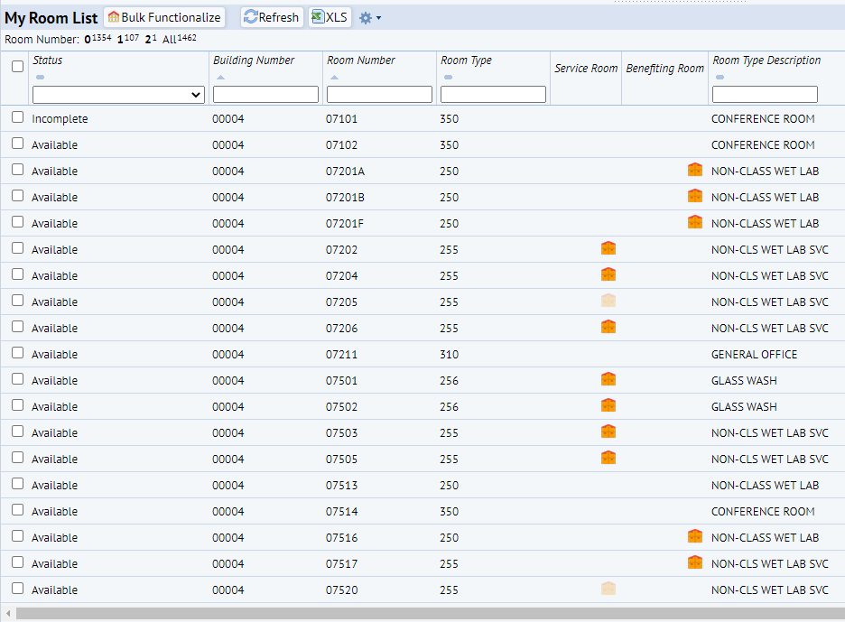
FY24P Example D – Service Rooms
Clicking on the dark or light ‘House’ in the ‘Service Room’ column will open a panel with a list of the current Benefiting rooms and a list of eligible benefitting rooms.
From the ‘My Rooms List’ you can click on a light or dark ‘House’ under the ‘Service Room’ header to open the ‘Service Room Selected’ panel. This will display any ‘Benefiting Rooms’ that are currently attached or can be attached.
Notes:
Room Split status for each record will be set to Available/Original—Any room split edits must be marked complete to be saved by May 31st
Room splits in an Incomplete or Pending status at the end of day on May 31st will automatically loose all edits to the room splits. They will not be saved.
Users will be required to update FY23 Survey and FY24P to correct your planning date.
Planning data must be Available and Original by May 31st, if you have outstanding records by May 31st, we will delete that edit and your planning data will be inaccurate. FY23 Survey will need to be updated and FY24P planning will also need updated.
Service room relationships to benefiting rooms will be retained
Overnight process will automatically split service room
It will NOT functionalize the service room in Space Planning.
IT WILL mark complete overnight and push to planning any edits you may have made to the benefiting rooms or relationship
Be sure to plan if you want to bulk functional during planning. – You can use bulk to just update Dept/RP : You will only need to do this if the activities room changed and the function will not be retained for FY23 Survey.

Slide 54
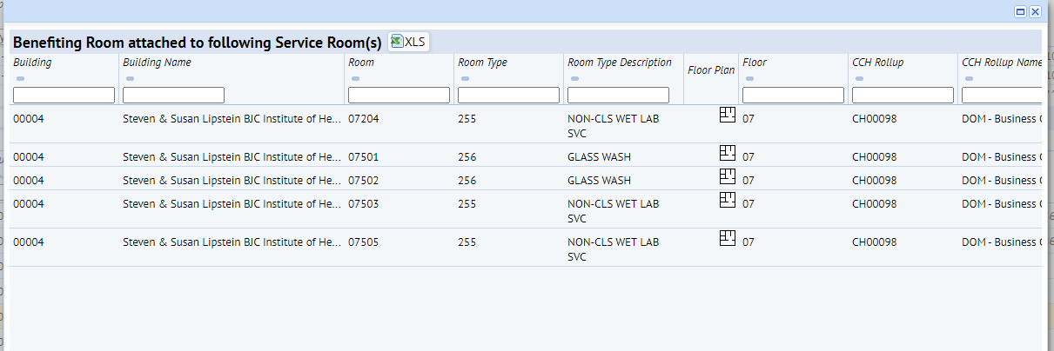
FY24P Example D – Benefiting Rooms
Clicking on the House’ in the ‘Benefiting Room’ column will open a panel with a list of the current Service rooms attached to the Benefiting room.
You cannot add or delete rooms from this panel
Notes:
Room Split status for each record will be set to Available/Original—Any room split edits must be marked complete to be saved by May 31st
Room splits in an Incomplete or Pending status at the end of day on May 31st will automatically loose all edits to the room splits. They will not be saved.
Users will be required to update FY23 Survey and FY24P to correct your planning date.
Planning data must be Available and Original by May 31st, if you have outstanding records by May 31st, we will delete that edit and your planning data will be inaccurate. FY23 Survey will need to be updated and FY24P planning will also need updated.
Service room relationships to benefiting rooms will be retained
Overnight process will automatically split service room
It will NOT functionalize the service room in Space Planning.
IT WILL mark complete overnight and push to planning any edits you may have made to the benefiting rooms or relationship
Be sure to plan if you want to bulk functional during planning. – You can use bulk to just update Dept/RP : You will only need to do this if the activities room changed and the function will not be retained for FY23 Survey.

Slide 55
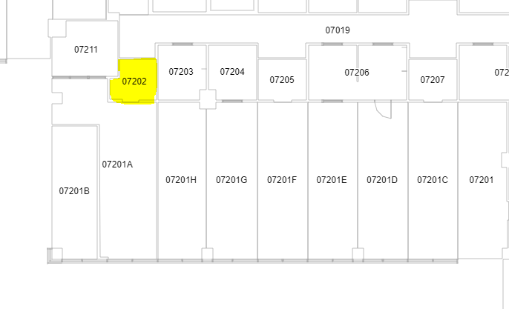
FY24P Example D – Service & Benefiting Room Example
Example:
Room 07202 is a shared service room that surrounding room 07201A & 07201B use. Room 07202 has met all the requirements to be a service room.
Benefiting Rooms
07201A
07201B
*Abbreviated BR
Notes:
Room Split status for each record will be set to Available/Original—Any room split edits must be marked complete to be saved by May 31st
Room splits in an Incomplete or Pending status at the end of day on May 31st will automatically loose all edits to the room splits. They will not be saved.
Users will be required to update FY23 Survey and FY24P to correct your planning date.
Planning data must be Available and Original by May 31st, if you have outstanding records by May 31st, we will delete that edit and your planning data will be inaccurate. FY23 Survey will need to be updated and FY24P planning will also need updated.
Service room relationships to benefiting rooms will be retained
Overnight process will automatically split service room
It will NOT functionalize the service room in Space Planning.
IT WILL mark complete overnight and push to planning any edits you may have made to the benefiting rooms or relationship
Be sure to plan if you want to bulk functional during planning. – You can use bulk to just update Dept/RP : You will only need to do this if the activities room changed and the function will not be retained for FY23 Survey.

Slide 56
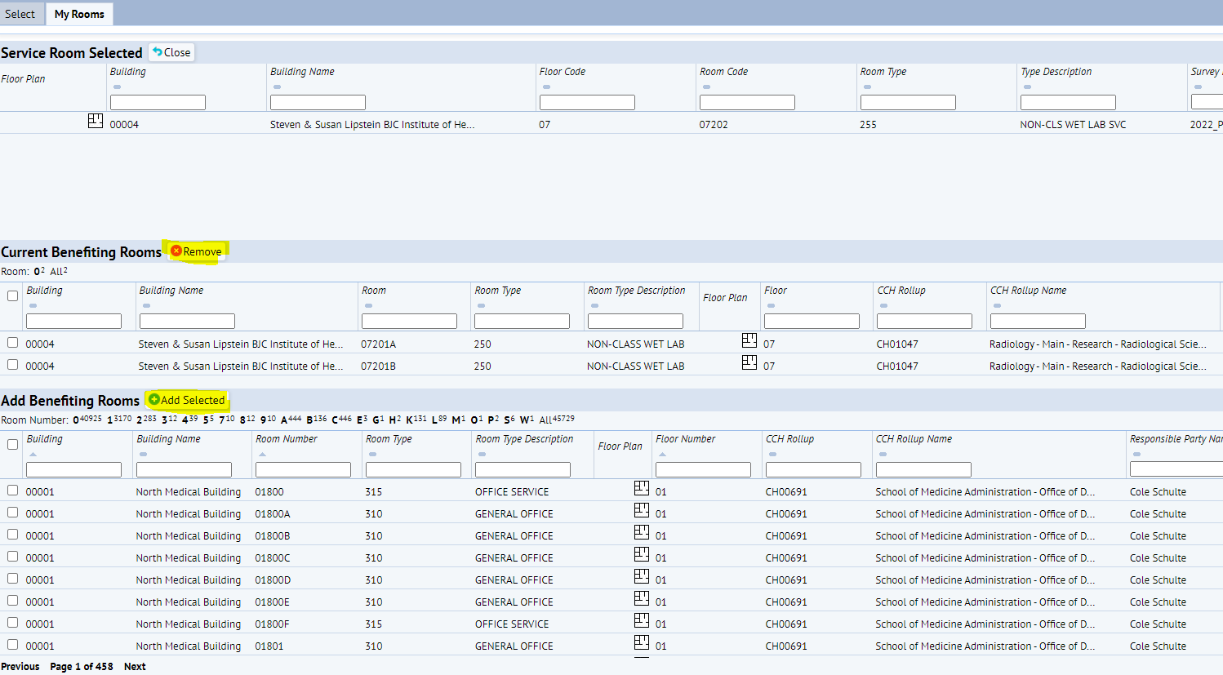
FY24P Example D – Service Rooms
You can check the boxes next to the rooms then click Add or Remove as needed. After clicking the dark orange house icon, Surveyor will see Rooms 07201A & 07201B as Current Benefiting Rooms assigned to shared Service Room 07202.
Notes:
Room Split status for each record will be set to Available/Original—Any room split edits must be marked complete to be saved by May 31st
Room splits in an Incomplete or Pending status at the end of day on May 31st will automatically loose all edits to the room splits. They will not be saved.
Users will be required to update FY23 Survey and FY24P to correct your planning date.
Planning data must be Available and Original by May 31st, if you have outstanding records by May 31st, we will delete that edit and your planning data will be inaccurate. FY23 Survey will need to be updated and FY24P planning will also need updated.
Service room relationships to benefiting rooms will be retained
Overnight process will automatically split service room
It will NOT functionalize the service room in Space Planning.
IT WILL mark complete overnight and push to planning any edits you may have made to the benefiting rooms or relationship
Be sure to plan if you want to bulk functional during planning. – You can use bulk to just update Dept/RP : You will only need to do this if the activities room changed and the function will not be retained for FY23 Survey.

Slide 57
FY24P Example D – Service & Benefiting Room Example (cont)
Notes:
Room Split status for each record will be set to Available/Original—Any room split edits must be marked complete to be saved by May 31st
Room splits in an Incomplete or Pending status at the end of day on May 31st will automatically loose all edits to the room splits. They will not be saved.
Users will be required to update FY23 Survey and FY24P to correct your planning date.
Planning data must be Available and Original by May 31st, if you have outstanding records by May 31st, we will delete that edit and your planning data will be inaccurate. FY23 Survey will need to be updated and FY24P planning will also need updated.
Service room relationships to benefiting rooms will be retained
Overnight process will automatically split service room
It will NOT functionalize the service room in Space Planning.
IT WILL mark complete overnight and push to planning any edits you may have made to the benefiting rooms or relationship
Be sure to plan if you want to bulk functional during planning. – You can use bulk to just update Dept/RP : You will only need to do this if the activities room changed and the function will not be retained for FY23 Survey.

Slide 58
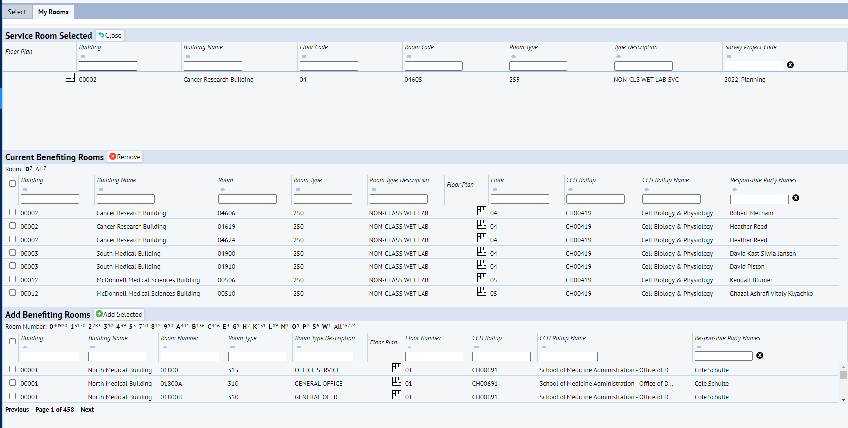
FY24P Example D – Service & Benefiting Room Example (cont)
5. When finished with changes, click the close button and it will take you back to the room split level.
3. To remove a benefiting room check the box next to the room under Current Benefiting Rooms and click the Remove Button. If this is the last room assigned to the Service room, the service room icon will fade to light orange.
4. To add a new benefiting room to a service room check the box next to the room under Add Benefiting Rooms and click the Add Selected button. If this is the first room assigned to the service room the service room icon will turn dark orange.
Notes:
Room Split status for each record will be set to Available/Original—Any room split edits must be marked complete to be saved by May 31st
Room splits in an Incomplete or Pending status at the end of day on May 31st will automatically loose all edits to the room splits. They will not be saved.
Users will be required to update FY23 Survey and FY24P to correct your planning date.
Planning data must be Available and Original by May 31st, if you have outstanding records by May 31st, we will delete that edit and your planning data will be inaccurate. FY23 Survey will need to be updated and FY24P planning will also need updated.
Service room relationships to benefiting rooms will be retained
Overnight process will automatically split service room
It will NOT functionalize the service room in Space Planning.
IT WILL mark complete overnight and push to planning any edits you may have made to the benefiting rooms or relationship
Be sure to plan if you want to bulk functional during planning. – You can use bulk to just update Dept/RP : You will only need to do this if the activities room changed and the function will not be retained for FY23 Survey.

Slide 59
FY24P Example D – Service & Benefiting Room Example (cont)
During Planning, you will only see the room splits update at the beginning of the month. At that time, if you do not like the way the splits were determined, you can always remove the Benefiting Rooms and do manual splits. Remember, if you remove this feature during planning, you changes might not show up until the following month in the system.
During Annual, the system will update overnight daily. You will see your splits update the next day.
Notes:
Room Split status for each record will be set to Available/Original—Any room split edits must be marked complete to be saved by May 31st
Room splits in an Incomplete or Pending status at the end of day on May 31st will automatically loose all edits to the room splits. They will not be saved.
Users will be required to update FY23 Survey and FY24P to correct your planning date.
Planning data must be Available and Original by May 31st, if you have outstanding records by May 31st, we will delete that edit and your planning data will be inaccurate. FY23 Survey will need to be updated and FY24P planning will also need updated.
Service room relationships to benefiting rooms will be retained
Overnight process will automatically split service room
It will NOT functionalize the service room in Space Planning.
IT WILL mark complete overnight and push to planning any edits you may have made to the benefiting rooms or relationship
Be sure to plan if you want to bulk functional during planning. – You can use bulk to just update Dept/RP : You will only need to do this if the activities room changed and the function will not be retained for FY23 Survey.

Slide 60
FY24P Example E – Recharge Centers
Recharge Centers
WU operating units that provide products and services for a fee, primarily to other University cost centers.
Each Recharge Center needs to be assigned space where the recharge center activity for the product/service takes place
Recharge Centers are assigned unique cost centers and added to the room split(s) where the recharge activities take place
Do you know you have a recharge center that needs space assigned, but you don’t know the cost center?
Contact Mitchell Baum
baumm@wustl.edu
Notes:
Room Split status for each record will be set to Available/Original—Any room split edits must be marked complete to be saved by May 31st
Room splits in an Incomplete or Pending status at the end of day on May 31st will automatically loose all edits to the room splits. They will not be saved.
Users will be required to update FY23 Survey and FY24P to correct your planning date.
Planning data must be Available and Original by May 31st, if you have outstanding records by May 31st, we will delete that edit and your planning data will be inaccurate. FY23 Survey will need to be updated and FY24P planning will also need updated.
Service room relationships to benefiting rooms will be retained
Overnight process will automatically split service room
It will NOT functionalize the service room in Space Planning.
IT WILL mark complete overnight and push to planning any edits you may have made to the benefiting rooms or relationship
Be sure to plan if you want to bulk functional during planning. – You can use bulk to just update Dept/RP : You will only need to do this if the activities room changed and the function will not be retained for FY23 Survey.

Slide 61
FY24P Example E – Recharge Centers
Scenario: You have a recharge center that has activity taking place in the Chemistry department
CH00054| Bldg 113 | Room 13 but notice it is missing the recharge cost center in the recharge center box.
Your recharge center cost center is CC0001132. You ran WD report RPT6352 to confirm the correct cost center before moving on to the next step.
Notes:
Room Split status for each record will be set to Available/Original—Any room split edits must be marked complete to be saved by May 31st
Room splits in an Incomplete or Pending status at the end of day on May 31st will automatically loose all edits to the room splits. They will not be saved.
Users will be required to update FY23 Survey and FY24P to correct your planning date.
Planning data must be Available and Original by May 31st, if you have outstanding records by May 31st, we will delete that edit and your planning data will be inaccurate. FY23 Survey will need to be updated and FY24P planning will also need updated.
Service room relationships to benefiting rooms will be retained
Overnight process will automatically split service room
It will NOT functionalize the service room in Space Planning.
IT WILL mark complete overnight and push to planning any edits you may have made to the benefiting rooms or relationship
Be sure to plan if you want to bulk functional during planning. – You can use bulk to just update Dept/RP : You will only need to do this if the activities room changed and the function will not be retained for FY23 Survey.

Slide 62
FY24P Example E – Recharge Centers
You can tell that there are currently no recharge centers assigned to the room since the column is blank under the “Recharge Center” heading.
You know that the room is still being utilized by Michael Gross 90% and that the Chemistry’s stockroom recharge activity now accounts for the remaining 10% of the space.
Notes:
Room Split status for each record will be set to Available/Original—Any room split edits must be marked complete to be saved by May 31st
Room splits in an Incomplete or Pending status at the end of day on May 31st will automatically loose all edits to the room splits. They will not be saved.
Users will be required to update FY23 Survey and FY24P to correct your planning date.
Planning data must be Available and Original by May 31st, if you have outstanding records by May 31st, we will delete that edit and your planning data will be inaccurate. FY23 Survey will need to be updated and FY24P planning will also need updated.
Service room relationships to benefiting rooms will be retained
Overnight process will automatically split service room
It will NOT functionalize the service room in Space Planning.
IT WILL mark complete overnight and push to planning any edits you may have made to the benefiting rooms or relationship
Be sure to plan if you want to bulk functional during planning. – You can use bulk to just update Dept/RP : You will only need to do this if the activities room changed and the function will not be retained for FY23 Survey.

Slide 63
FY24P Example E – Recharge Centers
You will need to Add a Split for the CC recharge center and reduce the % of Space for the existing split from 100% to 90%.
Click on the button
% of Space change - 10.00
Recharge Center - add STRM key
Date Effective – 7/1/2022
CCH Rollup – CH00054 A&S Chemistry
Responsible Party Name - enter business manager or other qualified party for the recharge center
Survey Comments – enter comments about why change is being made
Click the Save button
Notes:
Room Split status for each record will be set to Available/Original—Any room split edits must be marked complete to be saved by May 31st
Room splits in an Incomplete or Pending status at the end of day on May 31st will automatically loose all edits to the room splits. They will not be saved.
Users will be required to update FY23 Survey and FY24P to correct your planning date.
Planning data must be Available and Original by May 31st, if you have outstanding records by May 31st, we will delete that edit and your planning data will be inaccurate. FY23 Survey will need to be updated and FY24P planning will also need updated.
Service room relationships to benefiting rooms will be retained
Overnight process will automatically split service room
It will NOT functionalize the service room in Space Planning.
IT WILL mark complete overnight and push to planning any edits you may have made to the benefiting rooms or relationship
Be sure to plan if you want to bulk functional during planning. – You can use bulk to just update Dept/RP : You will only need to do this if the activities room changed and the function will not be retained for FY23 Survey.

Slide 64
FY24P Example E – Recharge Centers
You see that the split for the recharge center was added and CC0001132 appears under the Recharge Center column.
5. You will need to Edit the first split to reduce it’s % of Space to 90.00. Remember, splits can only be saved at 100%. We are now at 110 % of space. Click the blue pencil icon on the split that is not recharge and edit the split.
Click the Save button
Notes:
Room Split status for each record will be set to Available/Original—Any room split edits must be marked complete to be saved by May 31st
Room splits in an Incomplete or Pending status at the end of day on May 31st will automatically loose all edits to the room splits. They will not be saved.
Users will be required to update FY23 Survey and FY24P to correct your planning date.
Planning data must be Available and Original by May 31st, if you have outstanding records by May 31st, we will delete that edit and your planning data will be inaccurate. FY23 Survey will need to be updated and FY24P planning will also need updated.
Service room relationships to benefiting rooms will be retained
Overnight process will automatically split service room
It will NOT functionalize the service room in Space Planning.
IT WILL mark complete overnight and push to planning any edits you may have made to the benefiting rooms or relationship
Be sure to plan if you want to bulk functional during planning. – You can use bulk to just update Dept/RP : You will only need to do this if the activities room changed and the function will not be retained for FY23 Survey.

Slide 65
FY24P Example E – Recharge Centers
You now see that the Splits have been updated:
% of Space sums to 100.00
Recharge Center CC0001132 is listed on the newly added split
Date Effectives match
6. Press the button
Click the Yes button
Notes:
Room Split status for each record will be set to Available/Original—Any room split edits must be marked complete to be saved by May 31st
Room splits in an Incomplete or Pending status at the end of day on May 31st will automatically loose all edits to the room splits. They will not be saved.
Users will be required to update FY23 Survey and FY24P to correct your planning date.
Planning data must be Available and Original by May 31st, if you have outstanding records by May 31st, we will delete that edit and your planning data will be inaccurate. FY23 Survey will need to be updated and FY24P planning will also need updated.
Service room relationships to benefiting rooms will be retained
Overnight process will automatically split service room
It will NOT functionalize the service room in Space Planning.
IT WILL mark complete overnight and push to planning any edits you may have made to the benefiting rooms or relationship
Be sure to plan if you want to bulk functional during planning. – You can use bulk to just update Dept/RP : You will only need to do this if the activities room changed and the function will not be retained for FY23 Survey.

Slide 66
FY24P Example E – Recharge Centers
6. (continued)
You are curious, so you click on the button to review the transactions that were saved.
The room transactions show that up to FY22, Room 13 was utilized 100% by Michael Gross. Then beginning in FY23, room 13 is being utilized 90% by Michael Gross and the remaining 10% by Recharge Center CC0001132 Chemistry Stockroom.
Click the Ok button
Notes:
Room Split status for each record will be set to Available/Original—Any room split edits must be marked complete to be saved by May 31st
Room splits in an Incomplete or Pending status at the end of day on May 31st will automatically loose all edits to the room splits. They will not be saved.
Users will be required to update FY23 Survey and FY24P to correct your planning date.
Planning data must be Available and Original by May 31st, if you have outstanding records by May 31st, we will delete that edit and your planning data will be inaccurate. FY23Survey will need to be updated and FY24P planning will also need updated.
Service room relationships to benefiting rooms will be retained
Overnight process will automatically split service room
It will NOT functionalize the service room in Space Planning.
IT WILL mark complete overnight and push to planning any edits you may have made to the benefiting rooms or relationship
Be sure to plan if you want to bulk functional during planning. – You can use bulk to just update Dept/RP : You will only need to do this if the activities room changed and the function will not be retained for FY 23 Survey.

