Slide 1
Manage Space SSF & Recharge Centers Training

Slide 2
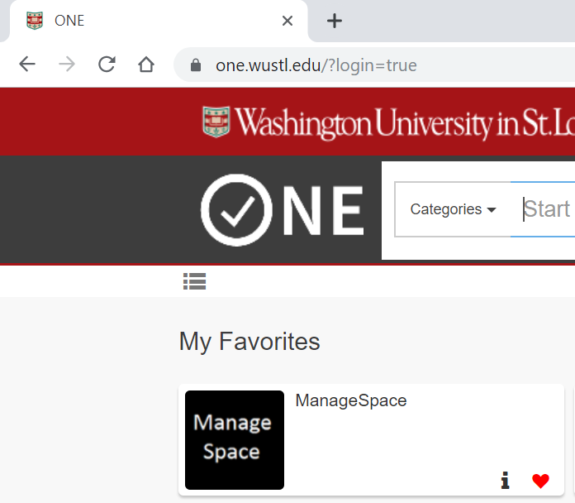
Logging on
Logon to ManageSpace
‘ManageSpace’ is web based and you can access it from One.WUSTL or from https://managespace.wustl.edu
Please add to your Bookmarks!
You must use Google Chrome and clear your cache for all time before you begin. (See next slide)
Notes:
How to logon to ManageSpace? You can access ManageSpace through one.wustl.edu or by typing managaespace.wustl.edu. You must only use Google Chrome and you will need to clear your cache for ‘All time’ before you start the survey.

Slide 3
Recharge Centers
Recharge Center Definition
WU operating units that provide products and services for a fee, primarily to other University departments.
Each Recharge Center needs to be assigned space where the recharge center activity for the product/service takes place
Recharge Centers are assigned “key” identifiers and the “keys” are attached to the room split(s) where the recharge activities take place
Do you know you have a recharge center that needs space assigned, but you don’t know the key identifier?
Contact Jenn Lankford
Jennifer.Lankford@wustl.edu

Slide 4
Specialized Service Facility (SSF)
SSF Definition
SSF’s are operating units that provide highly complex services primarily to other University departments and have total annual revenue (internal and external) of more than $1 million.
Each SSF needs to be assigned space where the activity for the product/service takes place
SSF’s are assigned “key” identifiers and the “keys” are attached to the room split(s) where the activities take place

Slide 5
Assigning Space
SSF / Recharge Center Space Guidelines:
Only 1 Recharge Center key identifier allowed per 1 Room Split
If your room contains more than 1 Recharge Center, then you will need to create a room split for each recharge center key identifier that needs assigned
Recharge Center is used to identify area within ManageSpace where the SSF or Recharge Center key is assigned.
During ANNUAL Survey, each room split with a Recharge Center key assigned needs to have Functional Code of 85-100%

Slide 6
Scenario 1 – Recharge 85 Report
You work in Cell Biology Department 3225. You were contacted by Cost Analysis to confirm space for Recharge Center identified as CBWASH Glassware Washing Facility. You’re not sure what space CBWASH is currently assigned to in ManageSpace.
SOLUTION:
Login to managespace.wustl.edu → Space Planning & Management → ManageSpace
Under “Reports”, Click on “Recharge 85”
Enter “CBWASH” under the Recharge Center heading.
Press Enter
Export results to Excel

Slide 7
Scenario 1 (cont) – Recharge 85 Report
5. You notice that there are two unique room numbers listed:
A. 01910B and 01910
B. There are two lines per room because each room has two function codes that add up to 100.
(Note that during ANNUAL Survey, you would see only Function Code 85 until the Recharge Process Runs and turns the 85 into the non-85 function codes)
6. After reviewing the Recharge 85 report results, you realize that the CBWASH recharge key needs to be added to space in Building 00012, Room 00557A.

Slide 8
Scenario 1 (cont) – Recharge 85 Report
7. In My Room List, you click on Room 00557A
8. You Edit or Add a split and add the recharge center key CBWASH
Enter Date Effective (if you are in PLANNING Survey cycle)
Enter % of Space for the Recharge Center room split
11. Enter Survey Comments explaining reason for the change
12. Save your changes
13. Mark Complete

Slide 9
Scenario 2 – Recharge Center
Cost Analysis contacted you because your recharge center ISOTOPE was not assigned to any room splits. You know the ISOTOPE instrument is located in:
Dept 1041 | Building 204 | Room 163.
You contact the PI to determine the % of Space in Room 163 that the recharge activity uses. The PI responds that the ISOTOPE is one of three instruments in the room so suggests 33%.
SOLUTION:
Login to managespace.wustl.edu and navigate to the Room
You notice that there is only one room split for non-recharge activity in the room. You must create another room split for the ISOTOPE Recharge Center activity.

Slide 10
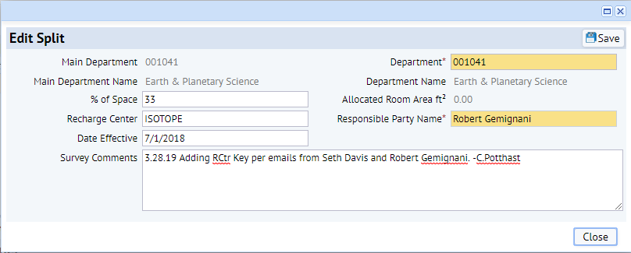
Scenario 2 – Recharge Center (cont)
SOLUTION (cont):
3. Steps to Add Room Split
a. Click on the button
b. Based on information provided by PI and Cost Analysis, you enter the following:
c. Press the button

Slide 11
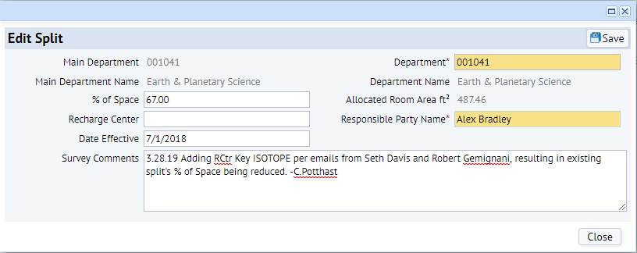
Scenario 2 – Recharge Center (cont)
SOLUTION (cont):
4. Next you need to Edit the original split to reduce its % of Space and to update the Date Effective.
a. Click on the icon and enter the following:
b. Press the button

Slide 12
Scenario 2 – Recharge Center (cont)
SOLUTION (cont):
5. Mark the Room Completed
6. You notice that both room splits status returned to Available/Original since you are in the Planning Survey period
7. You click the button and see the following transactions

Slide 13
ANNUAL Survey Functionalization
For Each SSF / Recharge Center Room Split:
Responsible Party should be Business Manager
“Key” identifying SSF / Recharge Center needs assigned to the room split
Occupants not required
Accounts not required
Functional Code tab should have Code 85 – SPEC SERVICE FACS saved at 100%
Surveyor Marks Complete

Slide 14
Scenario 3 – Recharge Center
You are responsible for the ISOTOPE recharge center. You created a room split for the recharge center during the PLANNING Survey cycle and now need to functionalize the split during the ANNUAL Survey cycle.
SOLUTION:
Login to managespace.wustl.edu and navigate to the Room
Dept 1041 | Building 204 | Room 163
2. You click on the recharge center room split to view the 4 Functional Tabs. Since this is a recharge center, Occupants are not required, so you click directly on the “Functional Code” tab.

Slide 15
Scenario 3 – Recharge Center (cont)
SOLUTION (cont):
3. Press the button within the Functional Code tab.
Add Function Code 85 at 100%. Press the button.
The Function Code now appears. Press the button.

Slide 16
Scenario 3 – Recharge Center (cont)
SOLUTION (cont):
Once Saved, the Function Code row turns Green.
Mark Completed. Note that in order for the entire room to move into Completed status that all of the room splits must be functionalized.
Recharge Center room split functionalization is only required during the ANNUAL Survey Cycle.

Slide 17
Function Code 85
Function Code 85 designates room splits where Recharge Center or SSF activities take place
During the ANNUAL Survey cycle, all of the room splits with a Recharge Center key identifier should have Functional Code 85-100%.
Occupants and Accounts are not required.
During the PLANNING Survey cycle, you will see recharge room splits without Code 85 because the 85 re-functionalizes into non-85 codes between ANNUAL Survey cycle ending and next PLANNING Survey cycle opening. See Next Slide

Slide 18
Code 85 Re-Functionalization
Recharge Room Splits functionalized with code 85 will be re-functionalized.
Recharge Room Split at end of ANNUAL Survey cycle
Split 1 MyRecharge IDC 85 100% Dept 1234 Curie
Recharge Process Runs
Recharge Center’s Income for Fiscal Year: $1,510,205.23
Recharge Center’s Customers Paid with Funds that Functionalize as:
82 $1,342,263.33 88.8795
83 7,550.00 0.4999*
86 3,150.00 0.2085*
95 23,870.00 1.5805
97 131,829.40 8.7292
92 1,542.50 0.1021*
$1,510,205.23 100.00
*If Original Function Code % < 1%, Recharge Process refunctionalizes and excludes the immaterial activities.
$1,342,263 89.61
23,870 1.59
131,829 8.80
$1,497,963 100.00
Recharge Room Split’s Function Codes after Recharge Process Runs*
Split 1 MyRecharge IDC 82 89.61% Dept 1234 Curie
IDC 95 1.59% Dept 1234 Curie
IDC 97 8.80% Dept 1234 Curie
* Non-85 codes will transfer to next PLANNING Survey cycle

Slide 19
Reporting Options
Manage Space
one.wustl.edu → ManageSpace
Overall Status Report → High-Level Departmental View of Your Space
Current Surveyors → Look up contacts in other departments
Exception Reports
Survey Split
Recharge 85 →
Enter your Department number and check for recharge centers assigned in your space
Enter your Recharge Center key and review space assigned to that key.
Room Lookup → Find out who has department access to a room
Survey Audit → Enter your Department number and check for errors
Cognos
one.wustl.edu → Cognos login → Team content → Space Reports
Fiscal Year 2020P is the archived FY20 PLANNING Survey data
Fiscal Year 2020M is the FY20 Med School Freeze data as of July 18, 2020
Fiscal Year 2020 is the FY20 ANNUAL Survey data
Visit https://space.wustl.edu/reports
for more information

Slide 20
Survey Audit – Recharge Error Type
Functional Code 85 is only allowed on room splits that have a Recharge Center key identifier assigned
Why did this room show up on the Survey Audit report?
1
2
Recharge Center key needs assigned.
Non-85 Functional Codes 95 and 82 (even though assigned with 0.00) need to be removed.

Slide 21
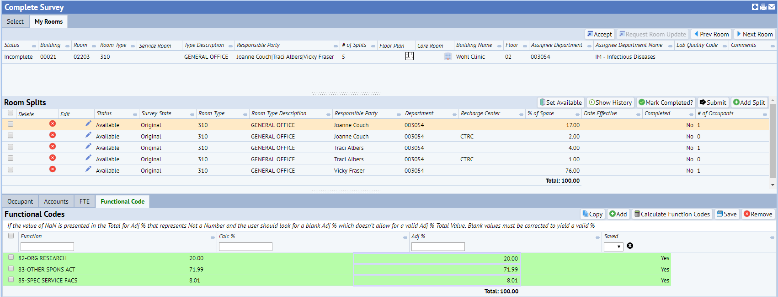
Survey Audit – Recharge Error Type
Watch for Occupants that are sourced to recharge center accounts and added to non-recharge related room splits.
Why did this room show up on the Survey Audit report?
1
2
Recharge Center key not assigned, so this split considered non-recharge split.
85 Functional Code should not appear on a non-recharge room split.

Slide 22
Survey Audit – Recharge Error Type
Steps to Correct:
Go to Occupant tab on the non-recharge room split. Press Reset button
Reset button retains the Occupant(s) but resets the Accounts | FTE | Functional Code tabs
Press Next
On the Accounts tab, remove any of the accounts that begin with an “85-” as these are recharge-related accounts and should not remain in the non-recharge room split
Press Next
On the FTE tab modify the Adj Relative FTE as needed
Since you pressed reset on the Occupant tab, once you get to the Functional Code tab the system recalculates without the “85” account and provides new %’s for the non-85 accounts.
Review %’s on Functional Code
Confirm that there are no 85’s
Save

Slide 23
Need Help?
Check out our website space.wustl.edu
Space Team Contacts:
Danforth
Scott Masterson masterson@wustl.edu
Jenn Lankford Jennifer.Lankford@wustl.edu
Jennifer Woods woods.j@wustl.edu
Med School
Cheryl Kilwin kilwinc@wustl.edu
Terrell Davis davis.terrell@wustl.edu

